Slide 1




Slide 2
Dear Teachers,
This is our freebie resource to introduce the first extracts of the Pre-Release Material for May/June 2027.
We like reading the extract before starting the practical exploration to get a first sense of the play. It means that students have read the extract and gives them time to ‘digest’ the plot and characters, before coming to their practical work and written work. It also means that when they do the practical work, they can draw on their knowledge of how the characters behave in the whole extract in order to shape their ideas.
There is some guidance on the next few slides for introducing the play using these slides. The slides that are white background are simply to communicate the lesson plan to you. The slides with black backgrounds are for use in class during the lesson. We just put them all into one easy download for the free pre-reading sample.
Then there are slides for various activities leading up to a first read and a few simple activities to help organise information. We find that students respond very well to having this kind of help with setting up their scripts and being organised - especially those who might usually be the kind to lose scripts, keep half-hearted notes. This is a great opportunity to teach skills of analysis and organisation of ideas. The fact that the extracts are only 15 pages or so means they can keep on top of it and feel successful.
The first set of slides for practical exploration is due out on or before 13 September.
If you would like to pre-order (especially if you need to pay via a bank transfer from school)
you can do so in the shop: www.the-understudy.org/shop.
Just choose ‘manual payment’ at check out in order to generate an invoice.
Otherwise you can buy an instant download as soon as they are published.
Kind regards,
Jane

Slide 3
Intro Lesson: Case File: The Man Who Hates Society
A 60-minute investigation and poetry trial introducing Alceste, from Molière's The Misanthrope (trans. Roger McGough)
Objectives: to build a picture of Alceste's character and central obsession — his refusal to flatter, and the cost of total honesty — by investigating him as a mystery before he is named, and then to feel the trap he despises from the inside, by performing exactly the kind of flattery he refuses to give, before discovering that this trap is a real scene in the play.
Before the Lesson: Setting the Scene
Room as incident room: arrange desks into 4–6 small "investigation team" pods rather than rows. A sign reading Case File: Unknown Subject or a simple manila folder on each pod's desk helps establish the fiction fast.
Witness statement cards: print and cut the six witness cards from the slide below, one set per team (or fewer cards per team if you want groups to pool findings afterwards — see the Investigation section for both options).
You, in two roles: you will play a brisk "Chief Investigator" for the opening briefing and reveal, then shift into a very different role — a vain, flattery-hungry Patron — for the second half. Plan a simple, visible costume or prop change (a scarf, a hat, glasses on/off) so students register the shift between the two.

Slide 4
1. The Case Briefing (3 min)
Greet the class in role as Chief Investigator — brisk, procedural, addressing them as "detectives" or "investigators" rather than by name. Distribute the case:
“We have a case. A man in Parisian high society — well known, much discussed, deeply divisive — has become the subject of an investigation. Some love him. Some can't stand him. Nobody agrees on what kind of man he really is. Your job: read the witness statements at your table, and build a profile. I want to know who this man is, and I want one word that captures what he's really like, underneath everything.”
2. The Investigation (12 min)
In teams, students read through the witness statement cards and discuss what each one reveals. Two ways to run this depending on group size and confidence:
• Whole-set version: each team gets all six cards and works through them together, building a single profile.
• Jigsaw version: each team gets only one or two cards and must present their partial evidence to the rest of the class before the full picture can be assembled — this raises the stakes and mimics real detective work, at the cost of a slightly longer share-back.
Each team should produce a short written profile answering three questions: What does this man value above everything else? What has it cost him? Is he, on the evidence so far, admirable, foolish, or both?

Slide 5
Witness card | Statement (as given to the investigation) | What it reveals
Witness A — his oldest friend | “He is my dearest friend, yet only yesterday I begged him to soften his opinions before he loses every friend he has left.” | He has close relationships that his own behaviour puts under strain.
Witness B — a woman he loves | “He says he loves me — and in the same breath tells me my other admirers are fools, and that I flatter them shamelessly. I rather enjoy him, but he does make things difficult.” | He is romantically entangled with someone whose values seem opposite to his own.
Witness C — a wounded acquaintance | “I showed him my finest poem and asked for his honest opinion, as a friend should. He gave it to me. I have not forgiven him.” | He tells the truth even when asked, politely, not to — and it costs him.
Witness D — an admirer | “Everyone in this city lies to be polite. He alone refuses. I confess I find it rather admirable.” | Not everyone thinks badly of him — his honesty has real defenders.
Witness E — a court official | “He has just lost a lawsuit — entirely his own doing. He wouldn't so much as compliment the judge.” | His principles have real, damaging practical consequences.
Witness F — the same old friend | “He says he wishes to leave society altogether and live far from other people. I don't think he means it. Or perhaps I hope he doesn't.” | He is threatening total withdrawal from the society that frustrates him.
Printable cards on next slide.

Slide 6
CASE FILE: UNKNOWN SUBJECT Witness Statement — No. 001 Witness A — his oldest friend “He is my dearest friend, yet only yesterday I begged him to soften his opinions before he loses every friend he has left.” Filed with the Investigation Bureau | CASE FILE: UNKNOWN SUBJECT Witness Statement — No. 002 Witness B — a woman he loves “He says he loves me — and in the same breath tells me my other admirers are fools, and that I flatter them shamelessly. I rather enjoy him, but he does make things difficult.” Filed with the Investigation Bureau
CASE FILE: UNKNOWN SUBJECT Witness Statement — No. 003 Witness C — a wounded acquaintance “I showed him my finest poem and asked for his honest opinion, as a friend should. He gave it to me. I have not forgiven him.” Filed with the Investigation Bureau | CASE FILE: UNKNOWN SUBJECT Witness Statement — No. 004 Witness D — an admirer “Everyone in this city lies to be polite. He alone refuses. I confess I find it rather admirable.” Filed with the Investigation Bureau
CASE FILE: UNKNOWN SUBJECT Witness Statement — No. 005 Witness E — a court official “He has just lost a lawsuit — entirely his own doing. He wouldn't so much as compliment the judge.” Filed with the Investigation Bureau | CASE FILE: UNKNOWN SUBJECT Witness Statement — No. 006 Witness F — the same old friend “He says he wishes to leave society altogether and live far from other people. I don't think he means it. Or perhaps I hope he doesn't.” Filed with the Investigation Bureau

Slide 7
3. Building the Profile (5 min)
Take one answer from each team to each of the three questions, building a composite profile on the board as you go (a simple three-column list works well: Values / Costs / Verdict). Before revealing anything, ask the class for a show of hands: admirable, foolish, or both? Note the split — you will return to it at the end of the lesson.
4. The Unmasking: Meet Alceste (7 min)
Break role deliberately and visibly. Reveal that the man under investigation is Alceste, the title character of Molière's The Misanthrope — and that everything on the board is true of him, drawn from what other characters say about him across the play. Deliver the context quickly:
This information is on a slide below for display.
• Alceste: obsessively, uncompromisingly honest, in a Parisian high society built on flattery and social performance. He refuses to soften his opinions for anyone, which makes him both the play's moral centre and, often, its fool.
• Célimène: the witty, flirtatious widow Alceste loves — and who is brilliant at exactly the social performance he despises, encouraging several admirers at once.
• Comedy of manners, in verse: Molière is satirising the customs and hypocrisies of aristocratic salon society. The play is written in rhymed alexandrines — elegant, formal verse — which makes the gap between beautiful language and petty, insincere behaviour part of the joke throughout.
Tell the class they are about to find out exactly what happens when someone asks Alceste for an honest opinion — but first, they're going to feel that trap from the other side.

Slide 8
5. The Patron's Challenge (4 min)
Shift visibly into your second role: a wealthy, vain Patron of the arts, hungry for admiration and utterly convinced of your own brilliance. Announce the competition:
“I am told there are poets among you. Good — I am in need of praise, and I intend to have the very best of it. Each of you will write me a poem. It need not be long — four to six lines will do — but it must rhyme, and it must flatter me outrageously. Choose your subject: my wit, my beauty, my taste, my brilliance — I am equally deserving of praise in all four. The finest poem wins my favour. The dull ones may leave.”
Set the brief clearly before writing begins: rhyming couplets (AABB), 4–6 lines minimum, aimed squarely at flattering the Patron with as much wit and invention as possible — the more extravagant and inventive the compliment, the better.
(slide below for display if needed)
6. Writing Time (11 min)
Students draft individually or in pairs. Circulate in role as the Patron, fishing shamelessly for hints (“Someone mention my exquisite taste in shoes”), which both models the task and keeps the fiction alive while students write. For students who get stuck, suggest choosing the flattering compliment first and finding the rhyme word to match it, rather than starting from the rhyme.

Slide 9
7. The Poetry Trial (10 min)
Reassemble as the Patron holding “court.” Students perform their poems one at a time (or in quick succession from their seats, if time is tight). React lavishly in role to the most extravagant flattery, and — this is important — visibly withhold approval from anything that sounds even slightly honest or restrained, reinforcing that in this room, only flattery is currency. Crown a winner with mock ceremony.
8. The Twist: Oronte's Sonnet (5 min)
Break role a final time. Tell the class that what they've just done — competing to flatter someone in verse, hungry for approval — is almost exactly what happens to a character named Oronte early in The Misanthrope: he reads Alceste a poem he's written and asks, apparently sincerely, for an honest opinion. Alceste tells him the truth: the poem is mediocre, overwrought, empty flattery dressed up as art. Oronte is wounded, furious, and the two become enemies over it.
• Ask: if Alceste had been the judge of today's poems instead of the Patron, what do you think he would have said about them?
• Ask: was Oronte wrong to be hurt — he did ask for honesty, after all — or is total honesty sometimes its own kind of cruelty?

Slide 11

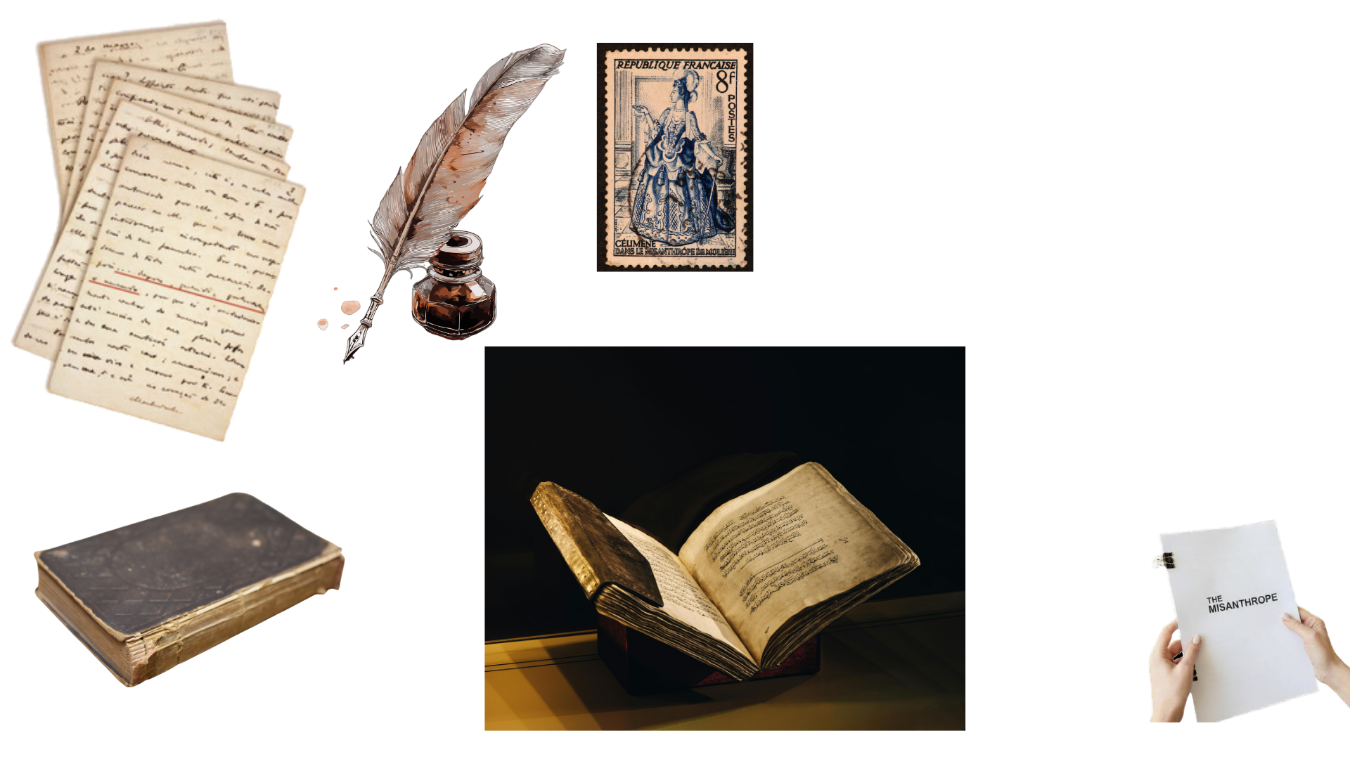





Alceste: obsessively, uncompromisingly honest, in a Parisian high society built on flattery and social performance. He refuses to soften his opinions for anyone, which makes him both the play's moral centre and, often, its fool.
Célimène: the witty, flirtatious widow Alceste loves — and who is brilliant at exactly the social performance he despises, encouraging several admirers at once.
Comedy of manners, in verse: Molière is satirising the customs and hypocrisies of aristocratic salon society. The play is written in rhymed alexandrines — elegant, formal verse — which makes the gap between beautiful language and petty, insincere behaviour part of the joke throughout.
A misanthrope is a person who dislikes, distrusts, or avoids other people and humankind in general.
© Jane Fisher

Slide 12

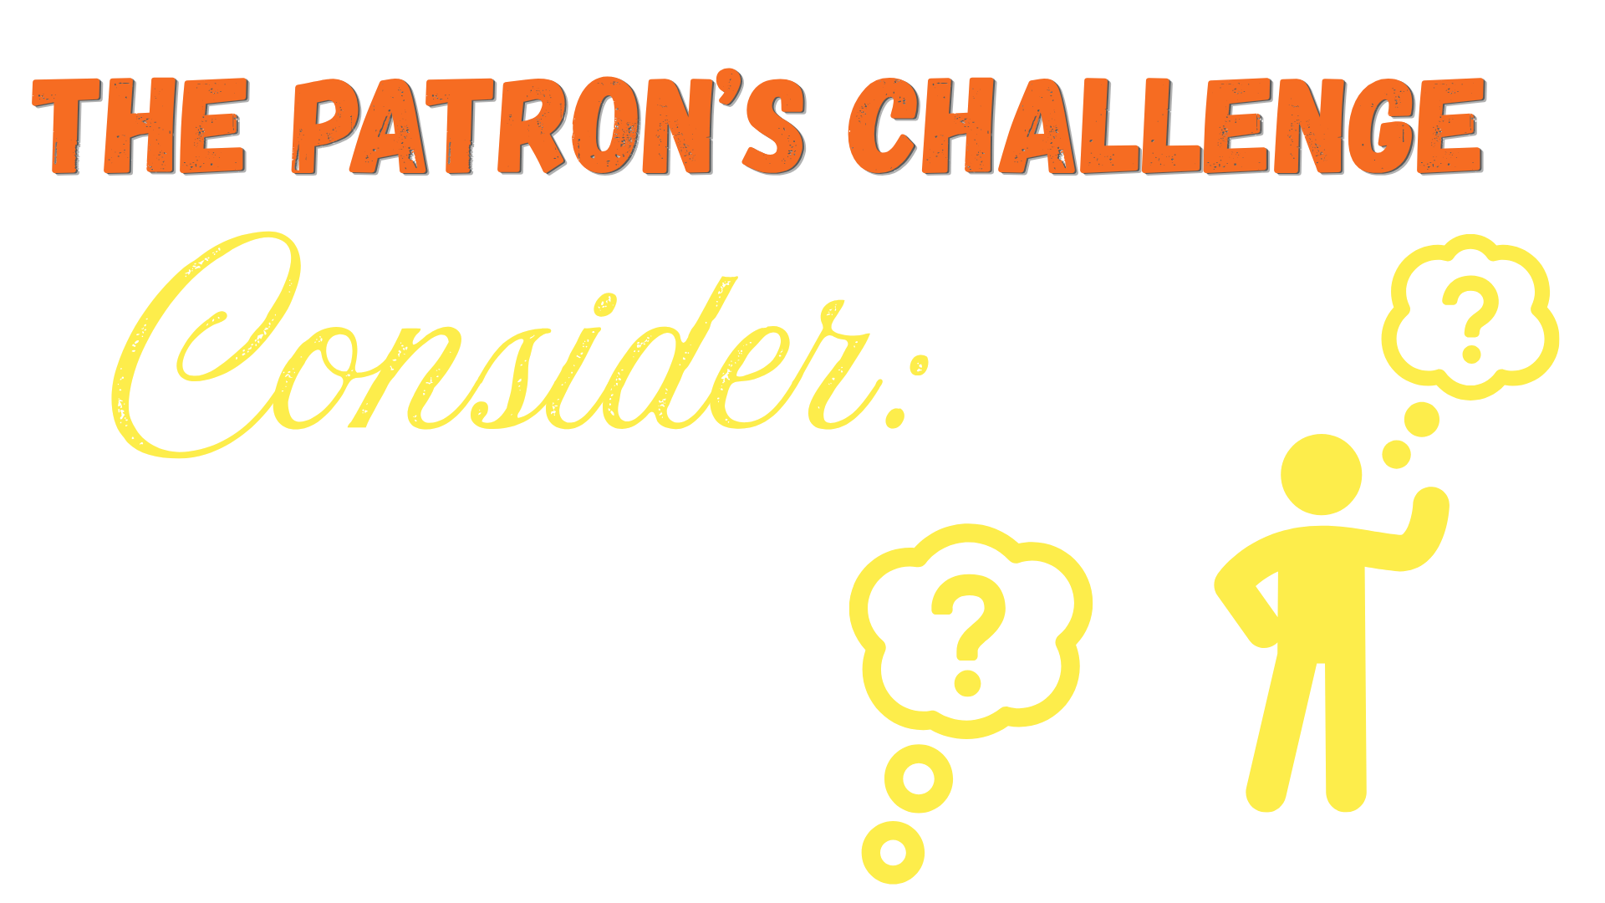

“I am told there are poets among you. Good — I am in need of praise, and I intend to have the very best of it. Each of you will write me a poem. It need not be long — four to six lines will do — but it must rhyme, and it must flatter me outrageously. Choose your subject: my wit, my beauty, my taste, my brilliance — I am equally deserving of praise in all four. The finest poem wins my favour. The dull ones may leave.”
The poem must be in rhyming couplets (AABB), 4–6 lines minimum, aimed squarely at flattering the Patron with as much wit and invention as possible — the more extravagant and inventive the compliment, the better.
© Jane Fisher

Slide 13
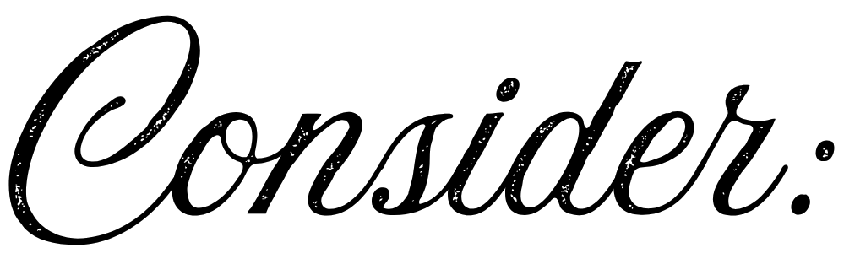


If Alceste had been the judge of today's poems instead of the Patron, what do you think he would have said about them?
Was Oronte wrong to be hurt — he did ask for honesty, after all — or is total honesty sometimes its own kind of cruelty?
© Jane Fisher

Slide 14
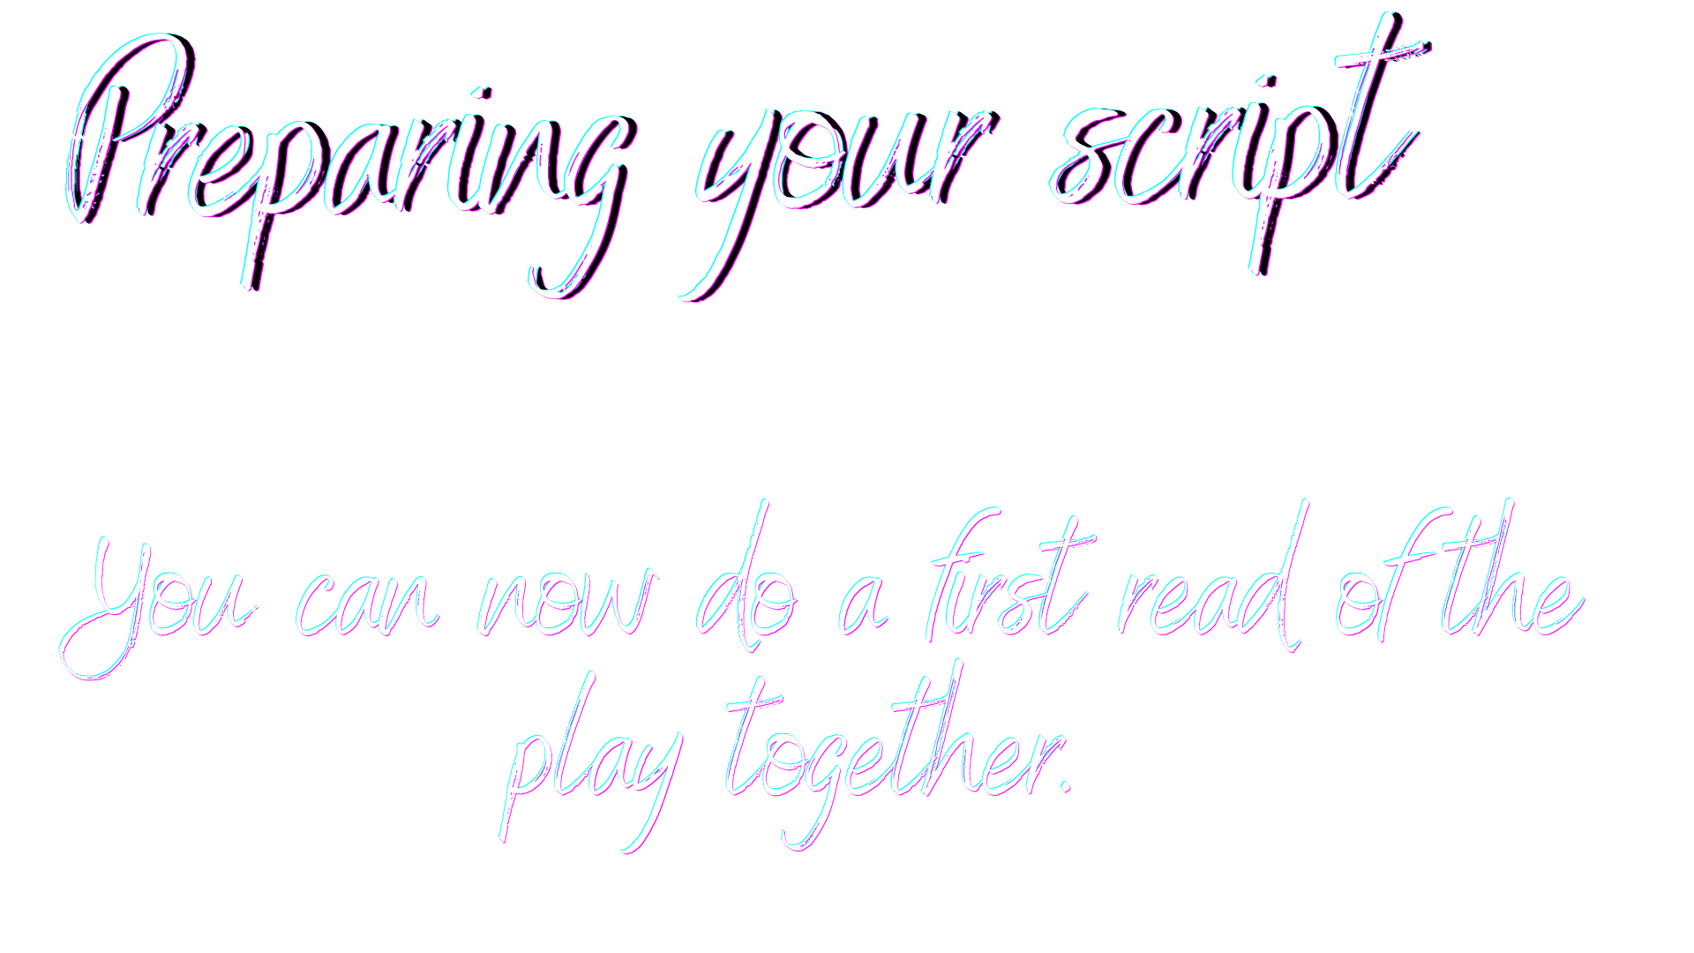
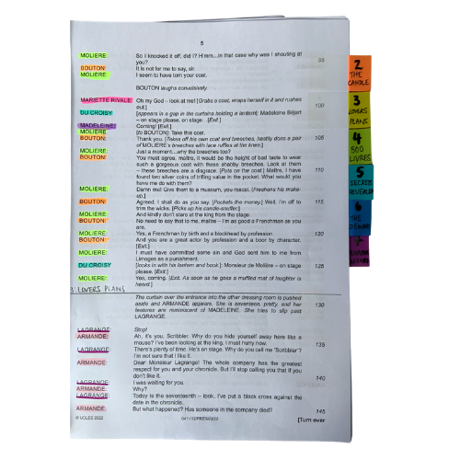
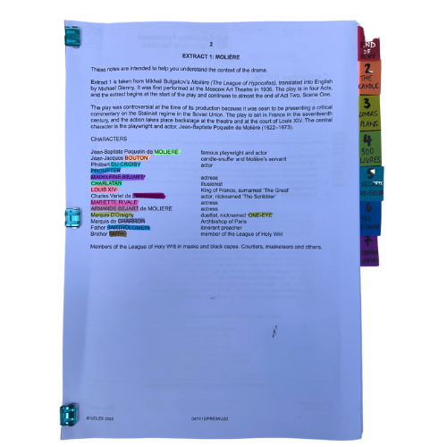




You will be working closely with this script for the next few months so get it organised, so you can access what you need easily, and you can easily see who is in a scene.
The script is two scenes. We’ve broken those down into seven units for our learning.
© Jane Fisher

Slide 15
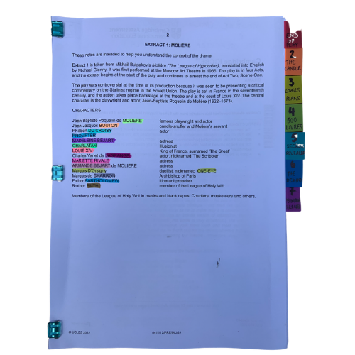
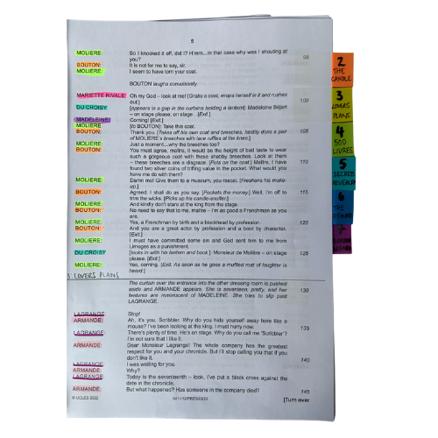

Choosing a colour for each character and highlighting your whole script allows you to see who is in each scene and makes reading in class (or to yourself) and experimenting with scenes much easier. It also allows you to see how prominent a character is.
Adding tabs to mark each section makes finding your place easy and helps organise the script in your head.
© Jane Fisher

Slide 16

Different directors/designers use different ways to decide where a unit starts and ends. Often an entrance or exit of a character is useful as it means characters’ intentions change. Each play is unique as is each decision about how to do this.
In drama analysis, directors and designers often break down the script into units. This makes it easier to analyse what is going on.
We like to give each unit a name to help us remember it and to be able to talk about it with our class / company. We try to choose names that are simple and easy reminders of events.
UNIT | 1 | 2 | 3 | 4 | 5 | 6 | 7
PAGES | 3-4 | 4-6 | 6- | 8-9 | 9-10 | 10-11 | 11-13
LINES | 1-87 | 88-161 | 162-260 | 265-317 | 318-380 | 381-442 | 443-509
NAME | NOT IN THE MOOD | THE TRUTH | FRIENDSHIP | RECITAL | THE BALLAD | JEALOUSY | TOO MUCH REGARD
© Jane Fisher

Slide 17
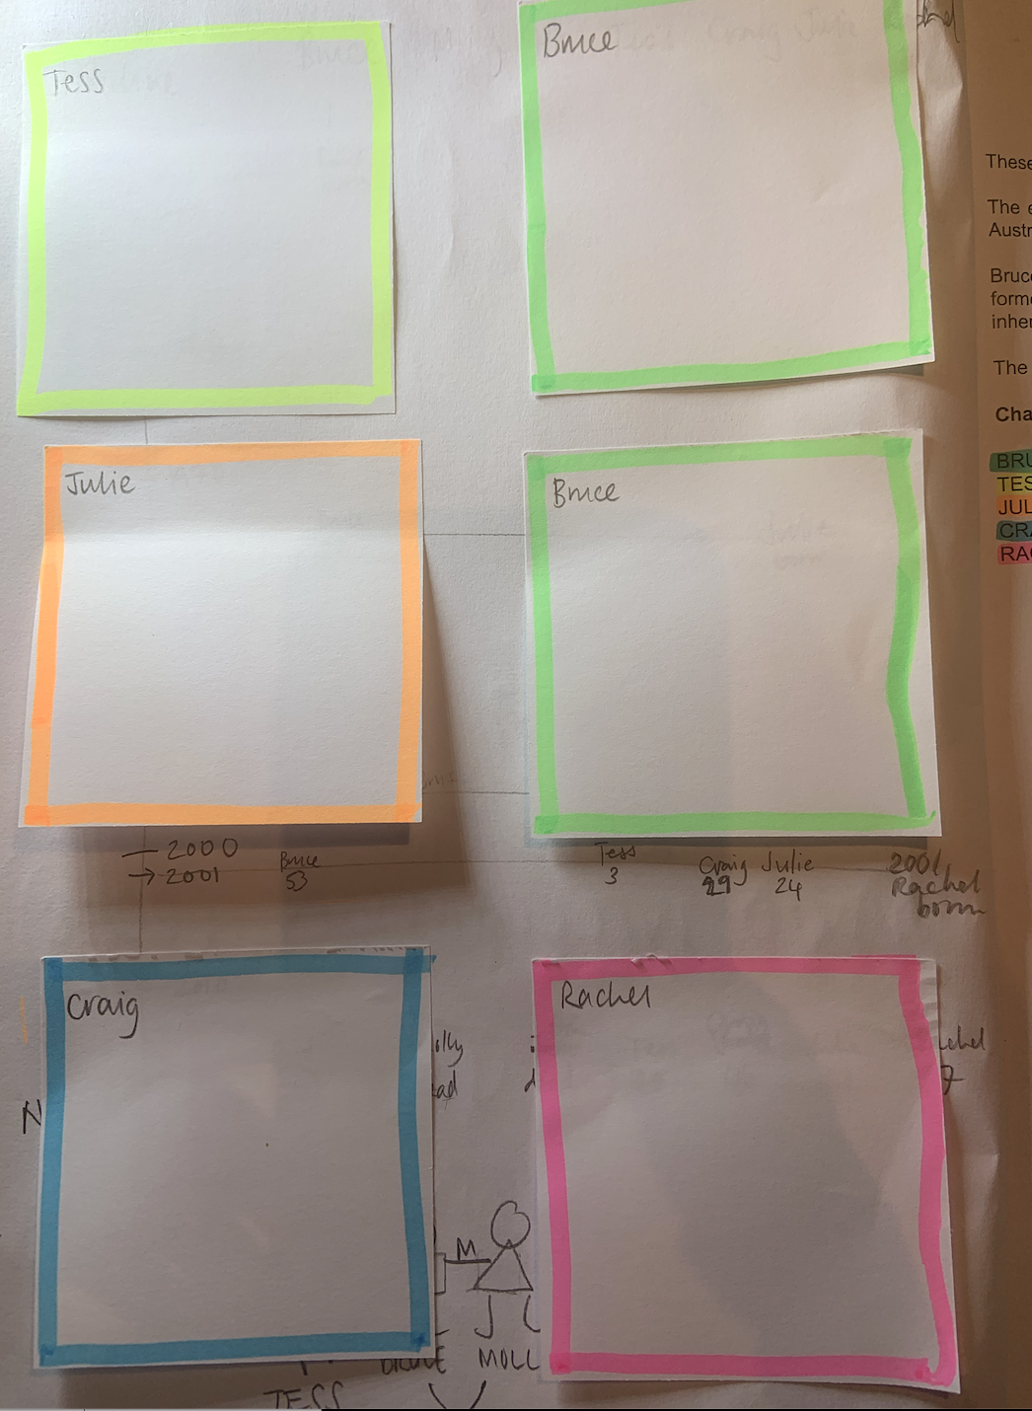
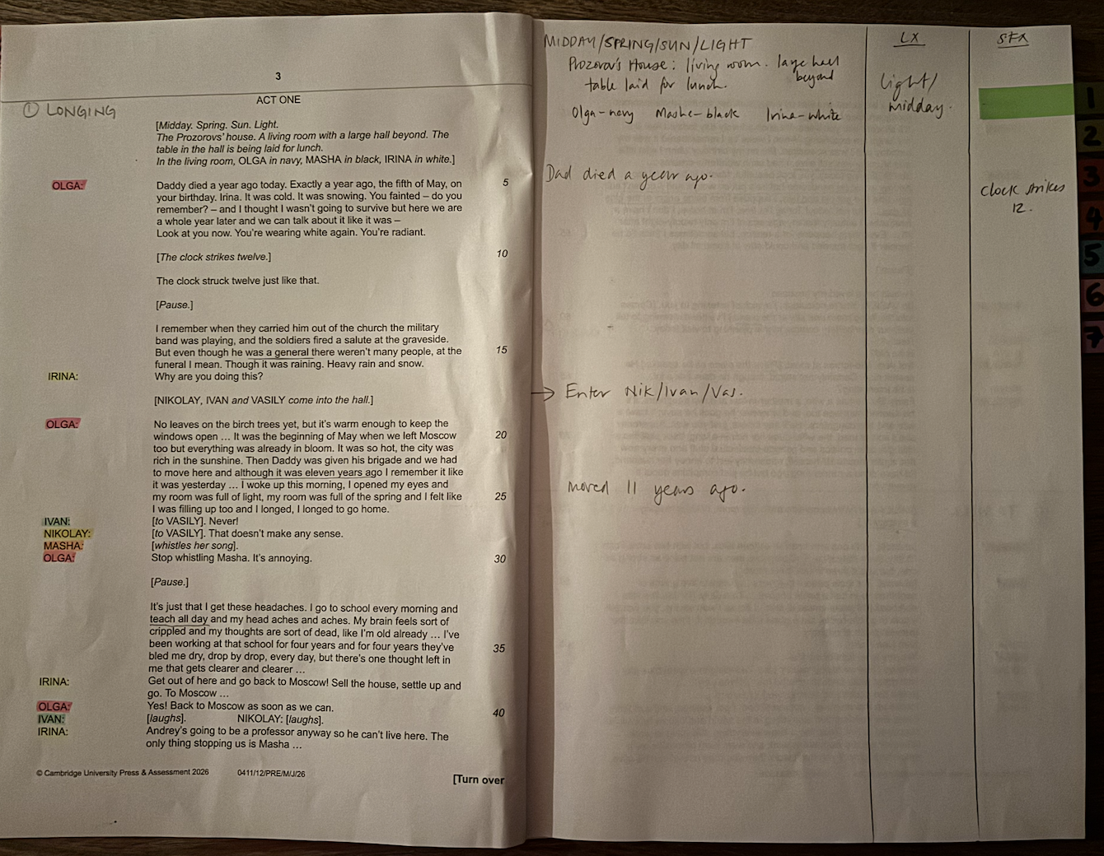
We print our script with a blank page next to each page for notes, diagrams for staging etc. We keep all notes in pencil so we can keep changing them as we go on.
On the front inside cover we use post-it notes to keep character notes. We can keep adding to these if needed.
TIPS FOR SCRIPT NOTES
Character Notes
Blank page for notes
© Jane Fisher

Slide 18

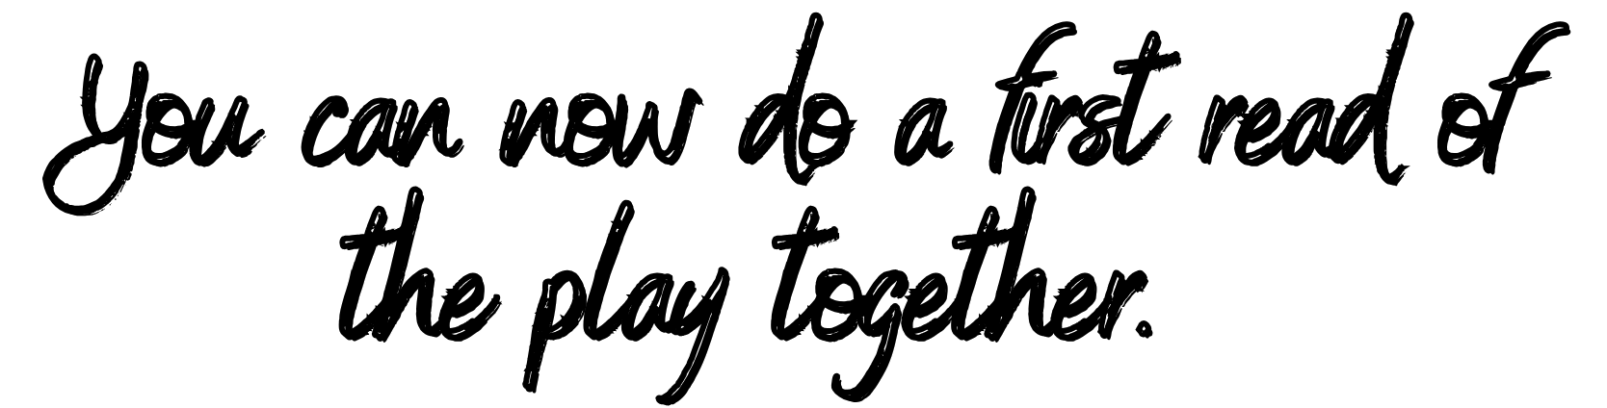


This could be quite fast so that you can enjoy the extract as a whole as much as possible. Don’t worry if you don’t understand everything; we will work through scene by scene after our first read. It’s easier to study the details once you have a sense of the piece as a whole.
© Jane Fisher

Slide 19

This resource is a freebie from
www.the-understudy.org
It is designed to help you set up your scripts so that you will find working with our slides to explore this play much easier. And you will feel organised before you embark on your exploration.
The full set of resources are published over a series of dates as we write and publish as we go, due to the time constraints of receiving new material each September. For more details, go to:
https://www.the-understudy.org/igcsedramapre-release
© Jane Fisher

