Slide 1



Slide 2

Dear Teachers,
This is our freebie resource to introduce the second extracts of the Pre-Release Material for May/June 2026.
We like to introduce the plays in a fun way then do a first read together before starting the detailed practical exploration and associated written practice.. It means that students have read the extract at least twice and gives them time to ‘digest’ the plot and characters, before coming to their practical work and written work. It means that when they do the practical work, they can draw on their knowledge of how the characters behave in the whole extract in order to shape their ideas.
There is some guidance on the next slide for introducing the play using these slides. Then there are slides for various activities leading up to a first read and a few simple activities to help organise information. We find that students respond very well to having this kind of help with setting up their scripts and being organised - especially those who might usually be the kind to lose scripts, keep half-hearted notes. This is a great opportunity to teach skills of analysis and organisation of ideas. The fact that the extracts are only 15 pages or less means they can keep on top of it and feel successful.
The second play’s first set of slides for practical exploration is due out on or before Sunday 16 November.
We expect it might be a little earlier, but don’t want to make promises we can’t keep.
If you would like to pre-order (especially if you need to pay via a bank transfer from school)
you can do so in the shop: www.the-understudy.org/shop
Otherwise you can buy an instant download as soon as they are published.
Kind regards,
Jane
© Jane Fisher

Slide 3
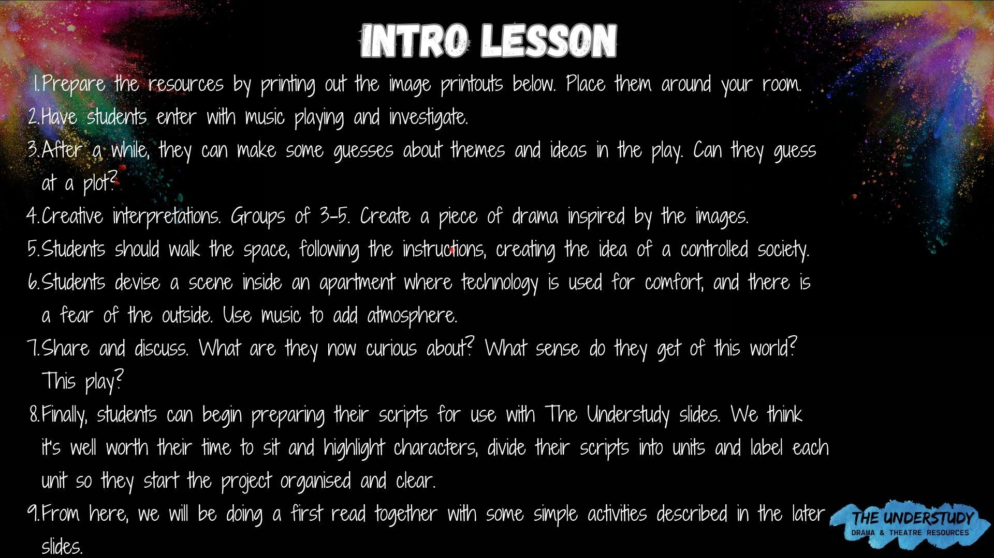
MUSIC OPTIONS
Frozen in Time - Dystopian Dark Ambience
Night City Market
SECTOR COMPILATION | 6 Hour Dystopian

Slide 4


Slide 5
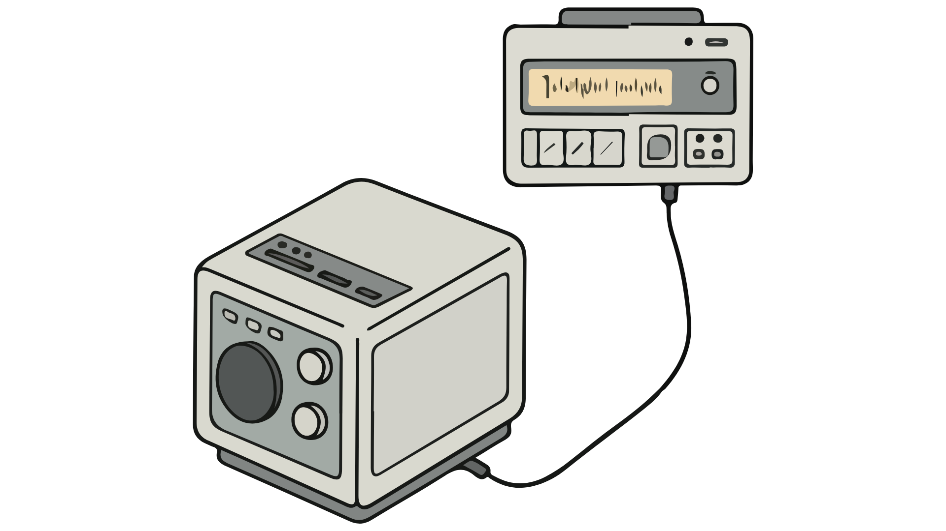

Slide 6


Slide 7


Slide 8


Slide 9


Slide 10


Slide 11


Slide 12


In groups of 3-5, create a piece of drama based on what you’ve seen so far. You don’t need to incorporate everything. Your piece can be realistic or stylised. It can be a scene or physical theatre or a mix. Text or no text. You can add music.

Slide 13
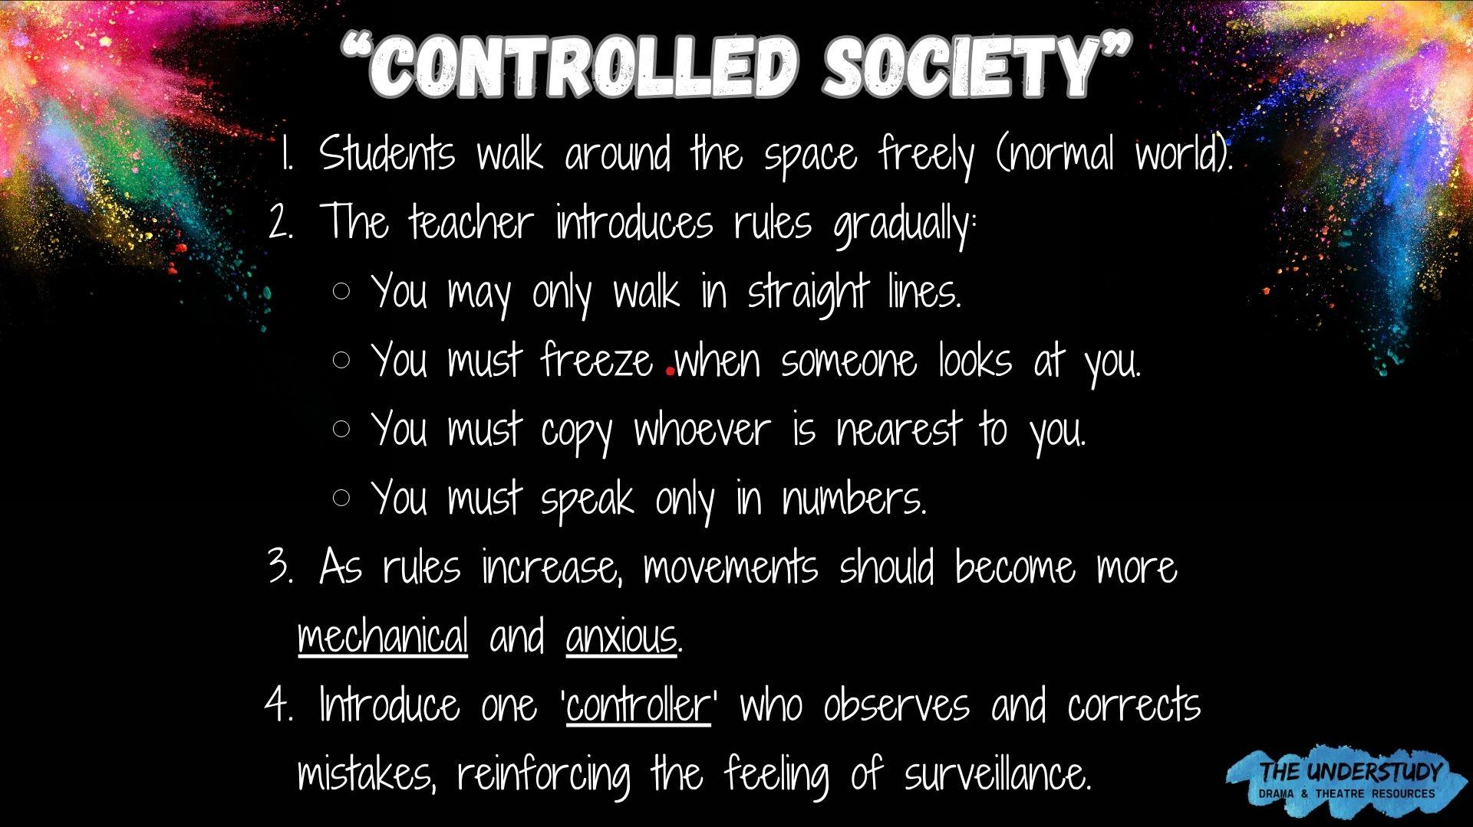

Slide 14
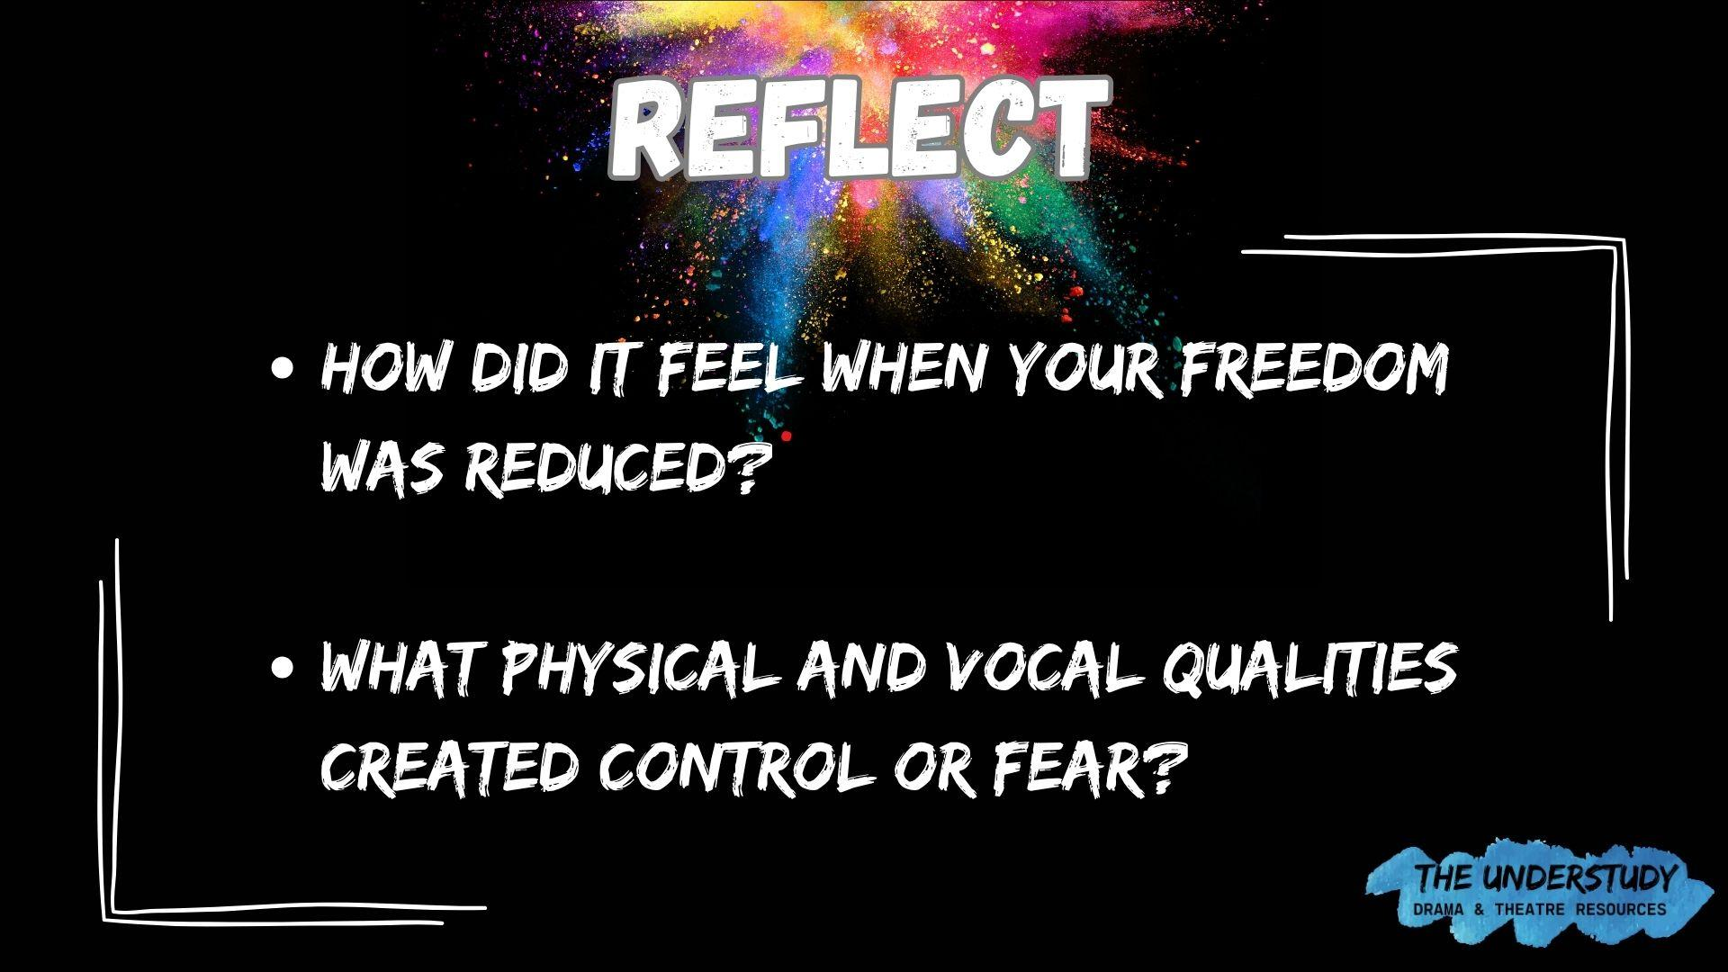

Slide 15
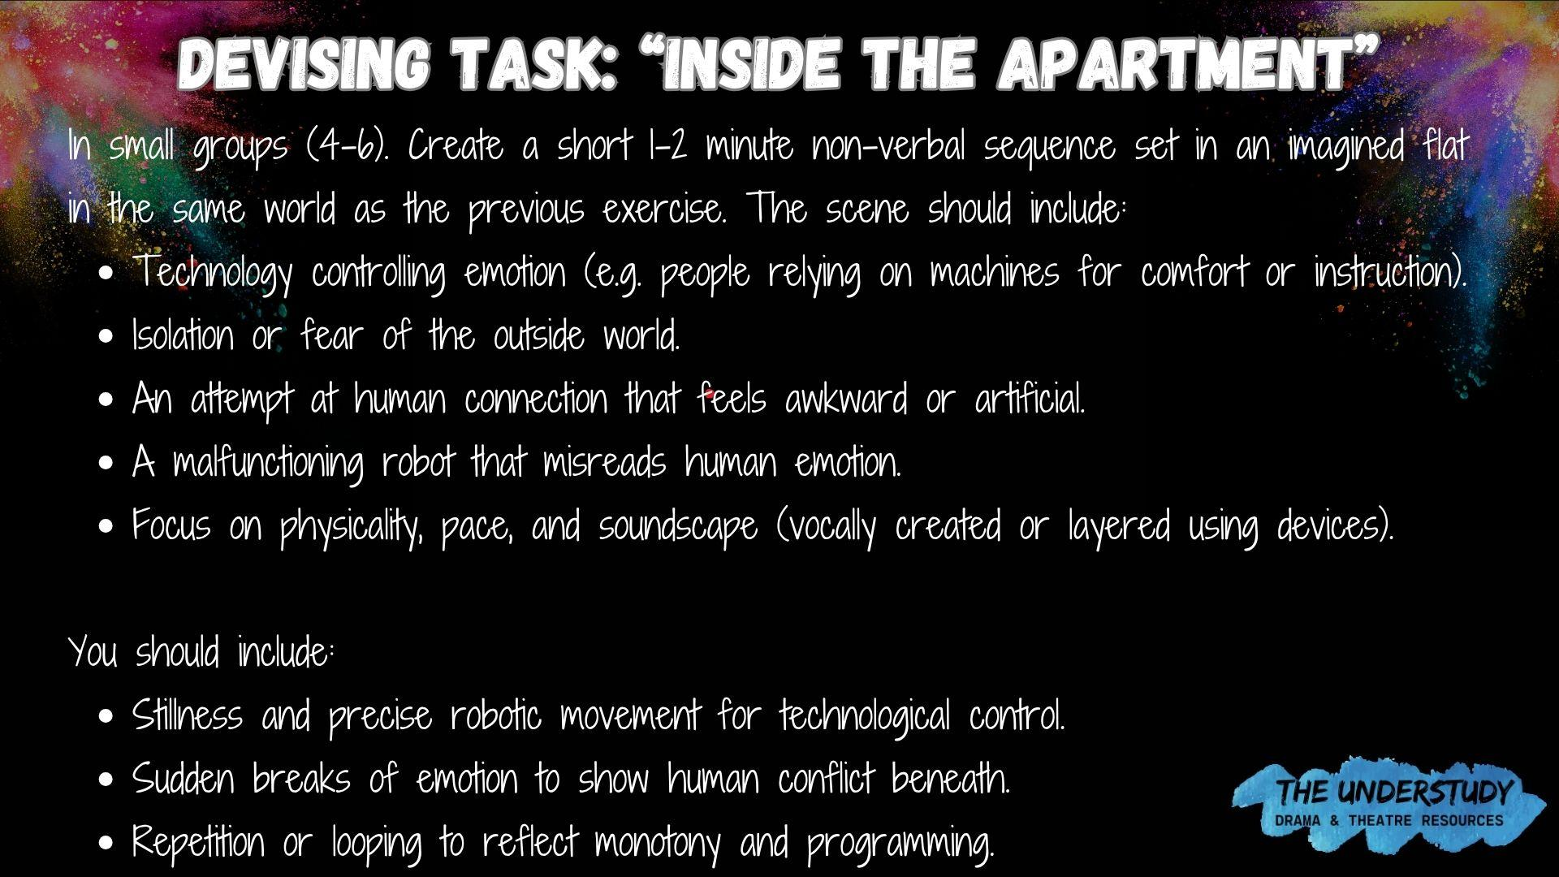

Slide 16
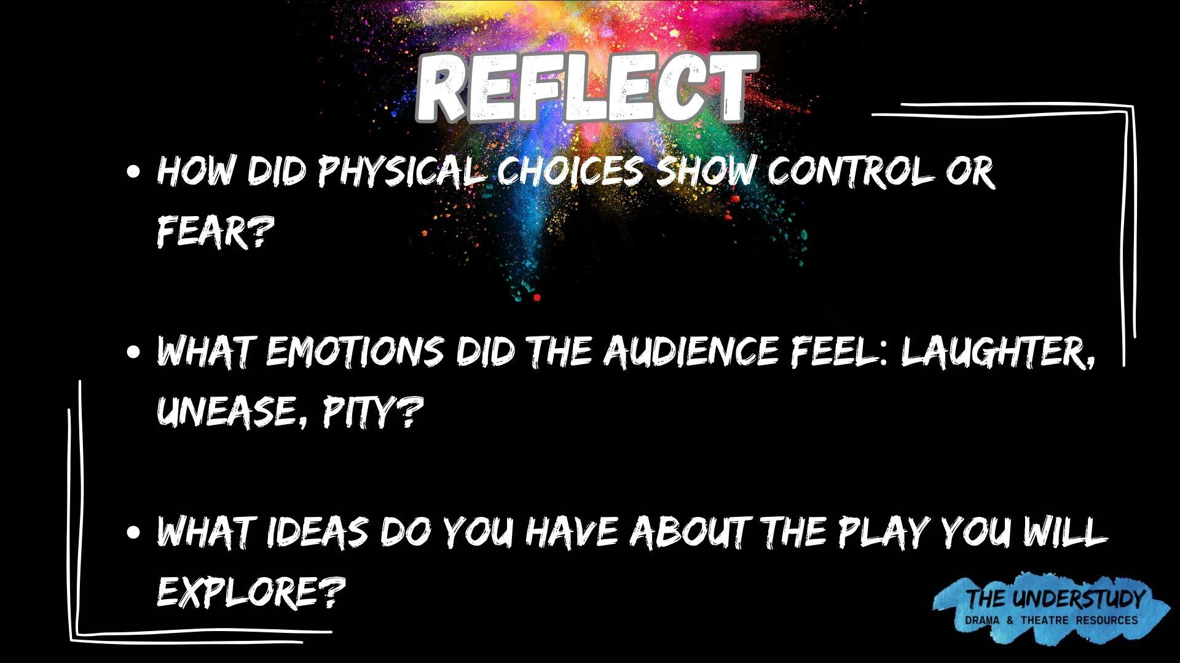

Slide 17

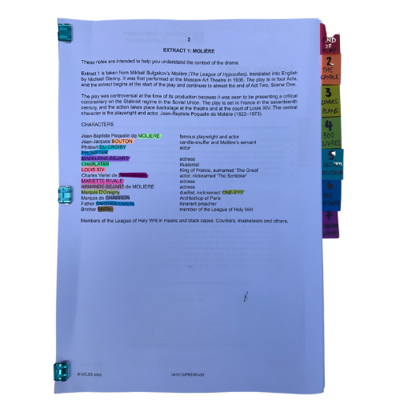
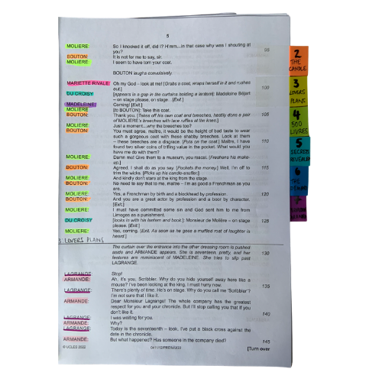


You will be working closely with this script for the next few months so get it organised, so you can access what you need easily, and you can easily see who is in a scene.
The script is two acts. We’ve broken those down into seven units for our learning.
© Jane Fisher

Slide 18

Choosing a colour for each character and highlighting your whole script allows you to see who is in each scene and makes reading in class (or to yourself) and experimenting with scenes much easier. It also allows you to see how prominent a character is.
Adding tabs to mark each section makes finding your place easy and helps organise the script in your head.
Choosing a colour for each character and highlighting your whole script allows you to see who is in each scene and makes reading in class (or to yourself) and experimenting with scenes much easier. It also allows you to see how prominent a character is.
Adding tabs to mark each section makes finding your place easy and helps organise the script in your head.
© Jane Fisher

Slide 19

In drama analysis, directors and designers often break down the script into units. This makes it easier to analyse what is going on.
Different directors/designers use different ways to decide where a unit starts and ends. Often an entrance or exit of a character is useful as it means, characters intentions change. Each play is unique as is each decision about how to do this.
Different directors/designers use different ways to decide where a unit starts and ends. Often an entrance or exit of a character is useful as it means characters’ intentions change. Each play is unique as is each decision about how to do this.
We like to give each unit a name to help us remember it and to be able to talk about it with our class / company. We try to choose names that are simple and easy reminders of events.
UNIT | 1 | 2 | 3 | 4 | 5 | 6 | 7
PAGES | 15-26 | 16 - 18 | 18 - 19 | 19 - 21 | 21 - 22 | 22 - 25 | 25 - 27
LINES | 1 - 67 | 27 - 121 | 122 - 182 | 183 - 251 | 252 - 333 | 334 - 442 | 443 - 520
NAME | MESSAGES | REBOOTING NAN | MALFUNCTIONING | THE MEETING | JEROME'S FIANĆE | SHE'S AN ACTRESS, SINGER AND A DANCER? | LUPUS CALLS AGAIN
© Jane Fisher

Slide 20
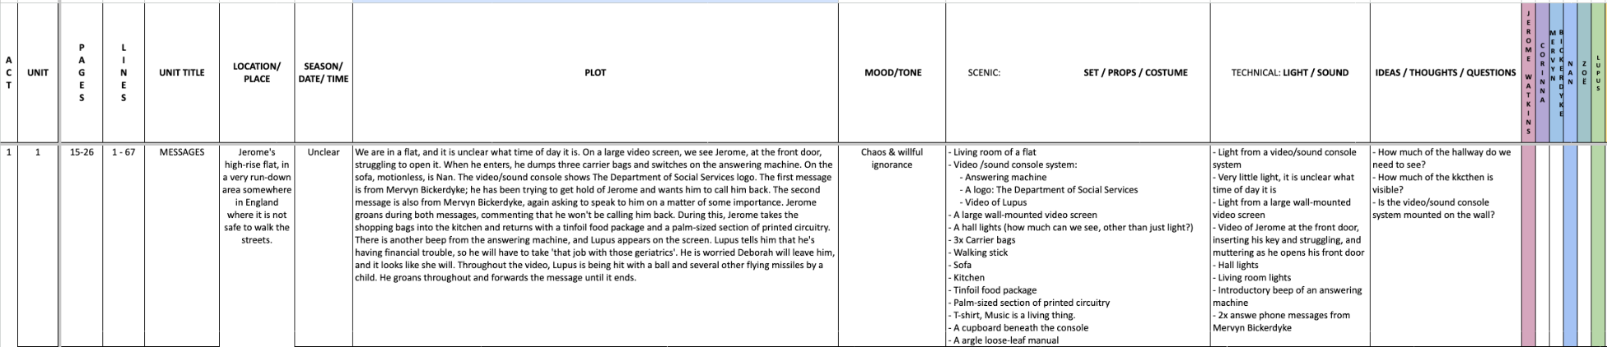
You can complete this document as a class or as individuals. You get deeper understanding and more attention to detail if you each do your own but you share ideas (and workload) if you do it together. Or you could each do your own then share and create a central document. It helps enormously with noticing details and understanding design requirements.
Here’s a blank template with just the first one done as an example
BLANK HENCEFORWARD UNITS.xlsx
© Jane Fisher

Slide 21

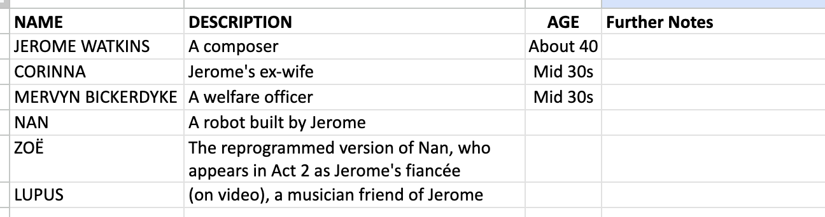
You can now read the script together and stop to complete your uniting document and begin a character study, so that when you come to do your second read and practical explorations, you know the characters and the plot of the whole extract and can draw on that knowledge in your activities and explorations of staging them. You can keep character notes on the second tab of the uniting sheets or you can keep notes in your script. See next slide.
© Jane Fisher

Slide 22
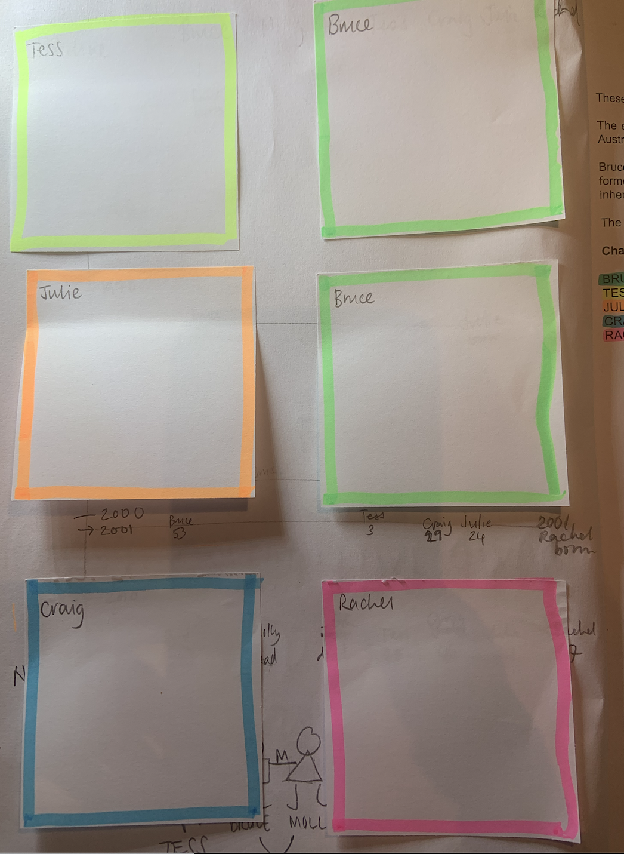
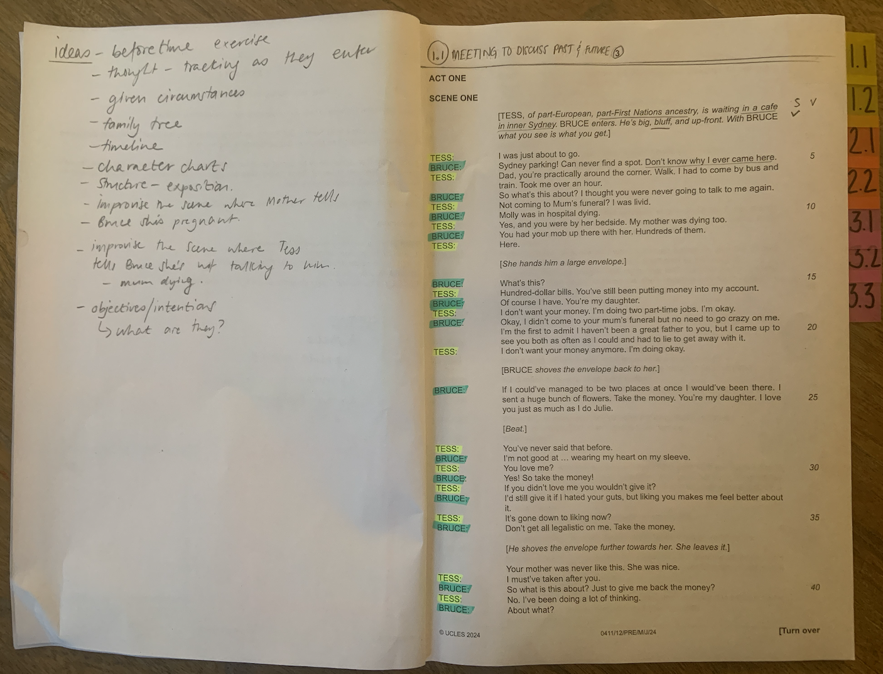
TIPS FOR SCRIPTS & NOTES
We print our script with a blank page next to each page for notes, diagrams for staging etc. We keep all notes in pencil so we can keep changing them as we go on. On the front inside cover we use post-it notes to keep character notes. We can keep adding to these if needed.
Character Notes
Blank page for notes
© Jane Fisher

Slide 23

This resource is a freebie from
www.the-understudy.org
It is designed to help you set up your scripts so that you will find working with our slides to explore this play much easier. And you will feel organised before you embark on your exploration.
The full set of resources are published over a series of dates as we write and publish as we go, due to the time constraints of receiving new material each September. For more details, go to:
https://www.the-understudy.org/igcsedramapre-release
© Jane Fisher

