Slide 1
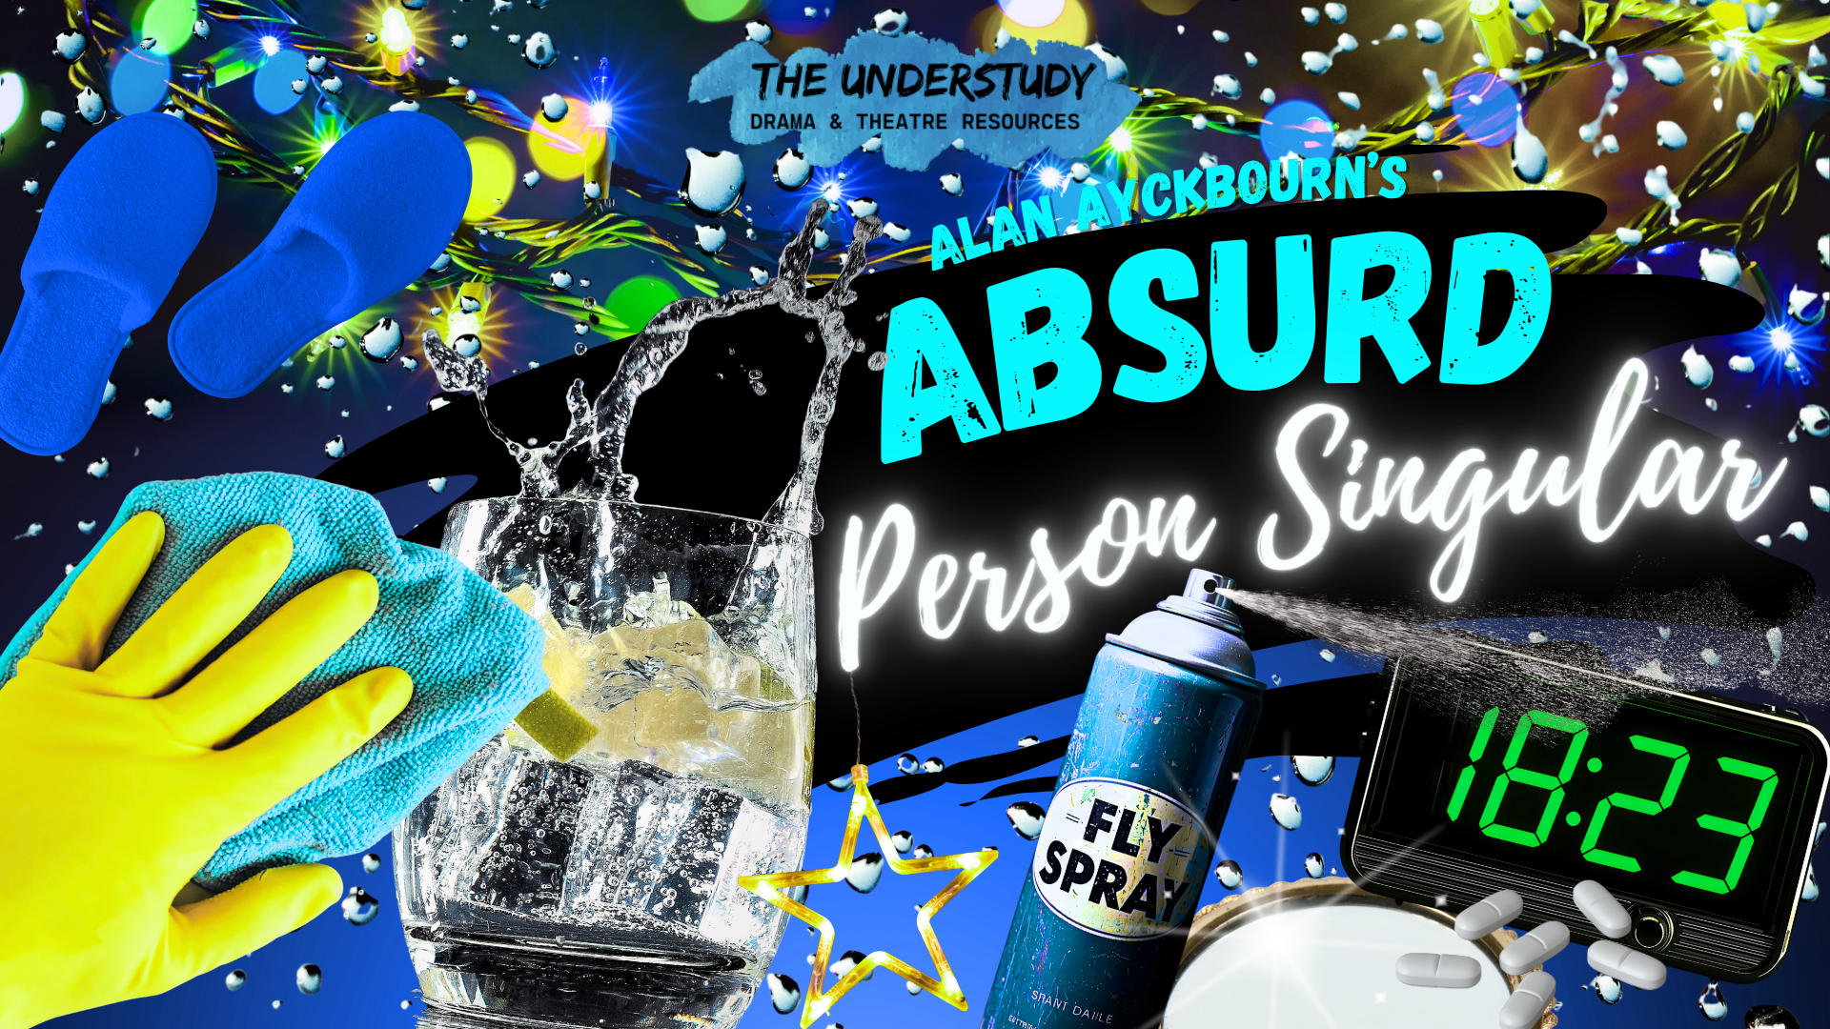


Slide 2

Dear Teachers,
This is our freebie resource to introduce the second extracts of the Pre-Release Material for May/June 2026.
We like to introduce the plays in a fun way then do a first read together before starting the detailed practical exploration and associated written practice.. It means that students have read the extract at least twice and gives them time to ‘digest’ the plot and characters, before coming to their practical work and written work. It means that when they do the practical work, they can draw on their knowledge of how the characters behave in the whole extract in order to shape their ideas.
There is some guidance on the next slide for introducing the play using these slides. Then there are slides for various activities leading up to a first read and a few simple activities to help organise information. We find that students respond very well to having this kind of help with setting up their scripts and being organised - especially those who might usually be the kind to lose scripts, keep half-hearted notes. This is a great opportunity to teach skills of analysis and organisation of ideas. The fact that the extracts are only 15 pages or less means they can keep on top of it and feel successful.
The second play’s first set of slides for practical exploration is due out on or before Sunday 16 November.
We expect it might be a little earlier, but don’t want to make promises we can’t keep.
If you would like to pre-order (especially if you need to pay via a bank transfer from school)
you can do so in the shop: www.the-understudy.org/shop
Otherwise you can buy an instant download as soon as they are published.
Kind regards,
Jane
© Jane Fisher

Slide 3
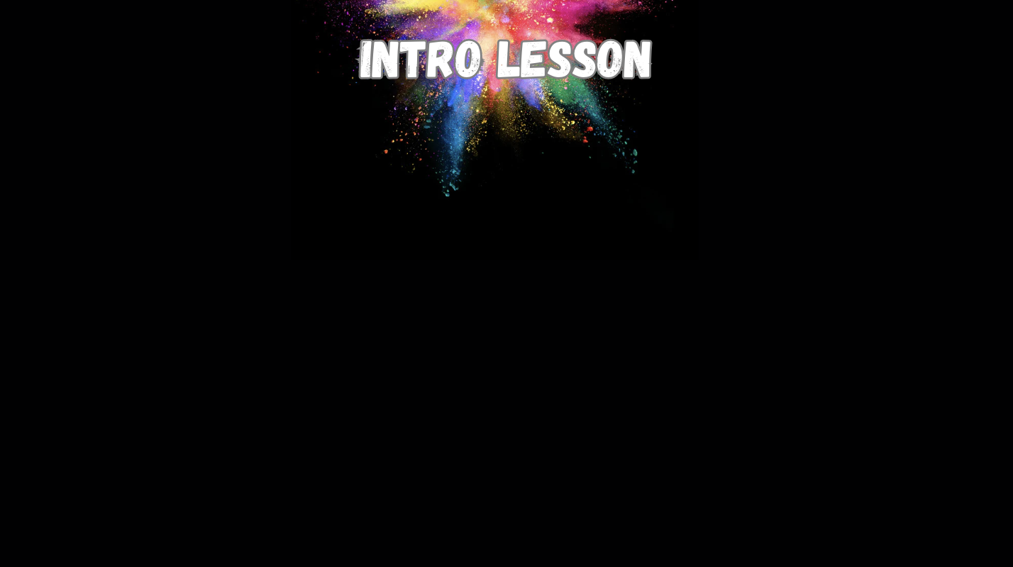

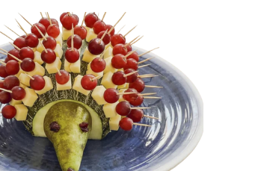
A Christmas Medley
Happy Xmas (War Is Over) (Ultimate Mix)
As we had so much fun with the party to introduce Three Sister, my suggestion is to start with a party again here. Set up your room like a Christmas party using whatever props / decor you have available. If starting this play in November, this will make more sense than for those of us starting January!
Start as teacher-in-role. Get yourself a little costume - either just an apron / pinafore or wear this over a party dress - 1970s style. Get some yellow rubber gloves and be cleaning and preparing the room as the students come in. When they arrive, quickly remove apron etc. Welcome them to your party and offer them hors d'oeuvres and a drink - those with time and money might make these real, otherwise just use empty glasses / plates (or even mime). Next slide can be used on the board.
Help them begin to form characters through improvisation by asking / offering names, jobs (for the men!) and children etc. Wish them Merry Christmas and comment that you can’t believe that it’s nearly 1973!
Give them the impression that they are all socially above you and you want to impress them.
Offer them each a quote (printouts at end of slide show).
6. They can work in small groups to create a scene at this party and they must find a way to incorporate their quotes into their scene. They can enjoy playing for comedy this time - but must stick to being 30-something adults in the 1970s.
7. Reflect: what kind of themes and ideas were emerging? What are you curious about? What sense do we get of the world of the play?
© Jane Fisher

Slide 4


Slide 5

CREATE A SCENE
Work in groups of 3-5.
Create a scene in which you use all of your quotes.
Your scene must be set at a Christmas Party in one of your homes in 1972.
You must all be middle class adults in your 30s. Some of you may be trying to impress others. You may play for comedy.

Slide 6


SHARE & REFLECT
What kind of themes and ideas are emerging?
What
sense do we get of the world of the play?
What are you curious about?

Slide 7
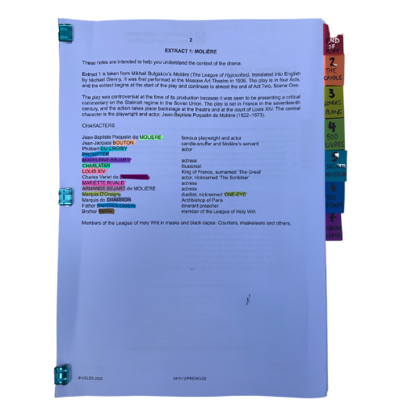
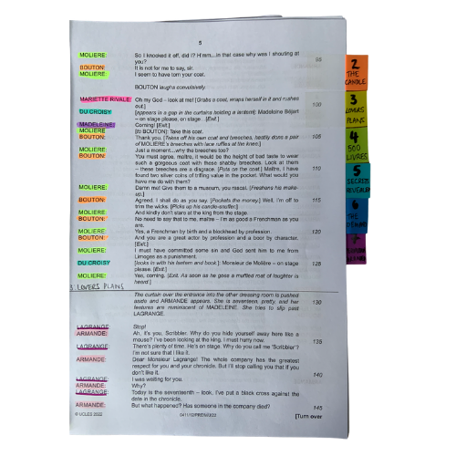


PREPARING YOUR SCRIPT
You will be working closely with this script for the next few months so get it organised, so you can access what you need easily, and you can easily see who is in a scene.
The script is two scenes. We’ve broken those down into seven units for our learning.
© Jane Fisher

Slide 8

PREPARING YOUR SCRIPT
Choosing a colour for each character and highlighting your whole script allows you to see who is in each scene and makes reading in class (or to yourself) and experimenting with scenes much easier. It also allows you to see how prominent a character is.
Adding tabs to mark each section makes finding your place easy and helps organise the script in your head.
© Jane Fisher

Slide 9
PREPARING YOUR SCRIPT
Different directors/designers use different ways to decide where a unit starts and ends. Often an entrance or exit of a character is useful as it means characters’ intentions change. Each play is unique as is each decision about how to do this.
In drama analysis, directors and designers often break down the script into units. This makes it easier to analyse what is going on.
We like to give each unit a name to help us remember it and to be able to talk about it with our class / company. We try to choose names that are simple and easy reminders of events.
UNIT | 1 | 2 | 3 | 4 | 5 | 6 | 7
PAGES | 18 - 20 | 20 - 23 | 23 - 25 | 25 - 26 | 26 - 27 | 27 - 28 | 28 -29
LINES | 1 - 131 | 132 - 253 | 254 - 354 | 355 - 424 | 425 - 463 | 464 - 525 | 525 - 569
NAME | GETTING READY | FIRST GUESTS | INSPECTING THE KITCHEN | SHELVES | RONALD & MARION | BEVERAGES | A MAD WORLD
© Jane Fisher

Slide 10

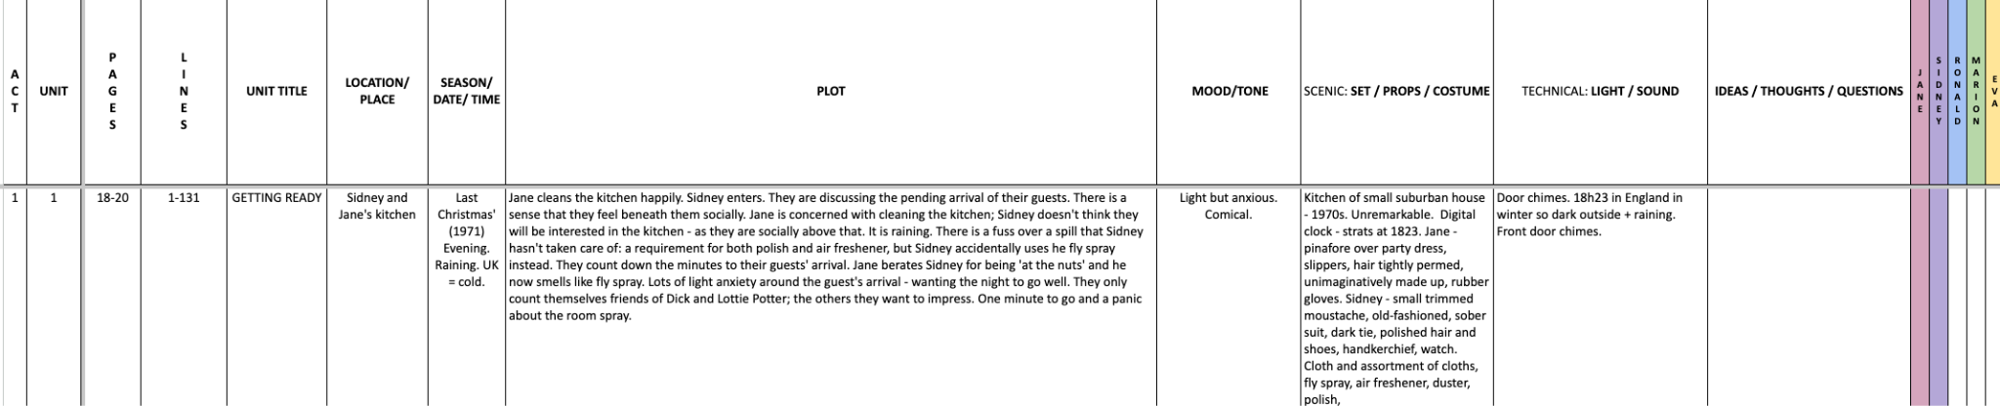
PREPARING YOUR SCRIPT
You can complete this document as a class or as individuals. You get deeper understanding and more attention to detail if you each do your own but you share ideas (and workload) if you do it together. Or you could each do your own then share and create a central document. It helps enormously with noticing details and understanding design requirements.
Here’s a blank template with just the first one done as an example
BLANK ABSURD PERSON UNITS.xlsx
© Jane Fisher

Slide 11
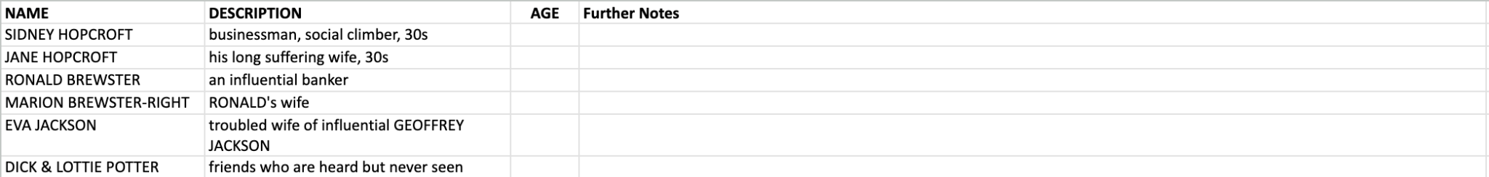
READ THE SCRIPT TOGETHER
You can now read the script together and stop to complete your uniting document and begin a character study, so that when you come to do your second read and practical explorations, you know the characters and the plot of the whole extract and can draw on that knowledge in your activities and explorations of staging them. You can keep character notes on the second tab of the uniting sheets or you can keep notes in your script. (See next slide.)
© Jane Fisher

Slide 12
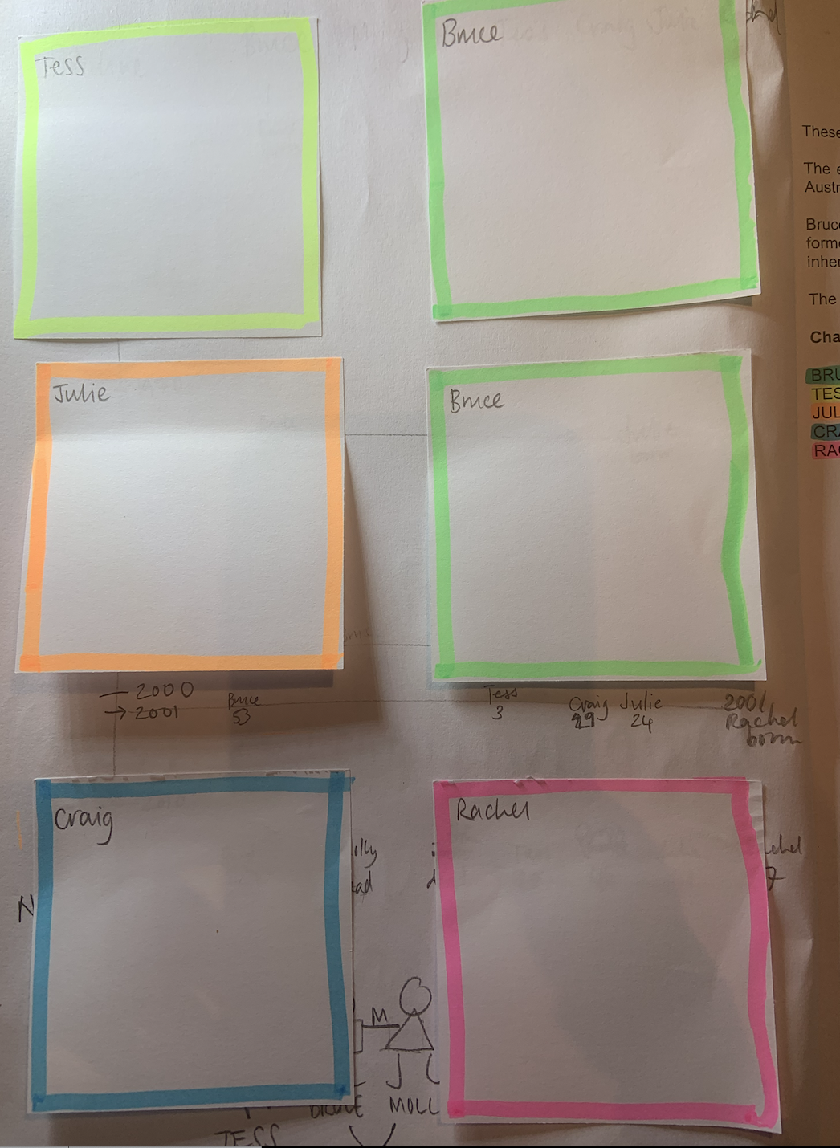
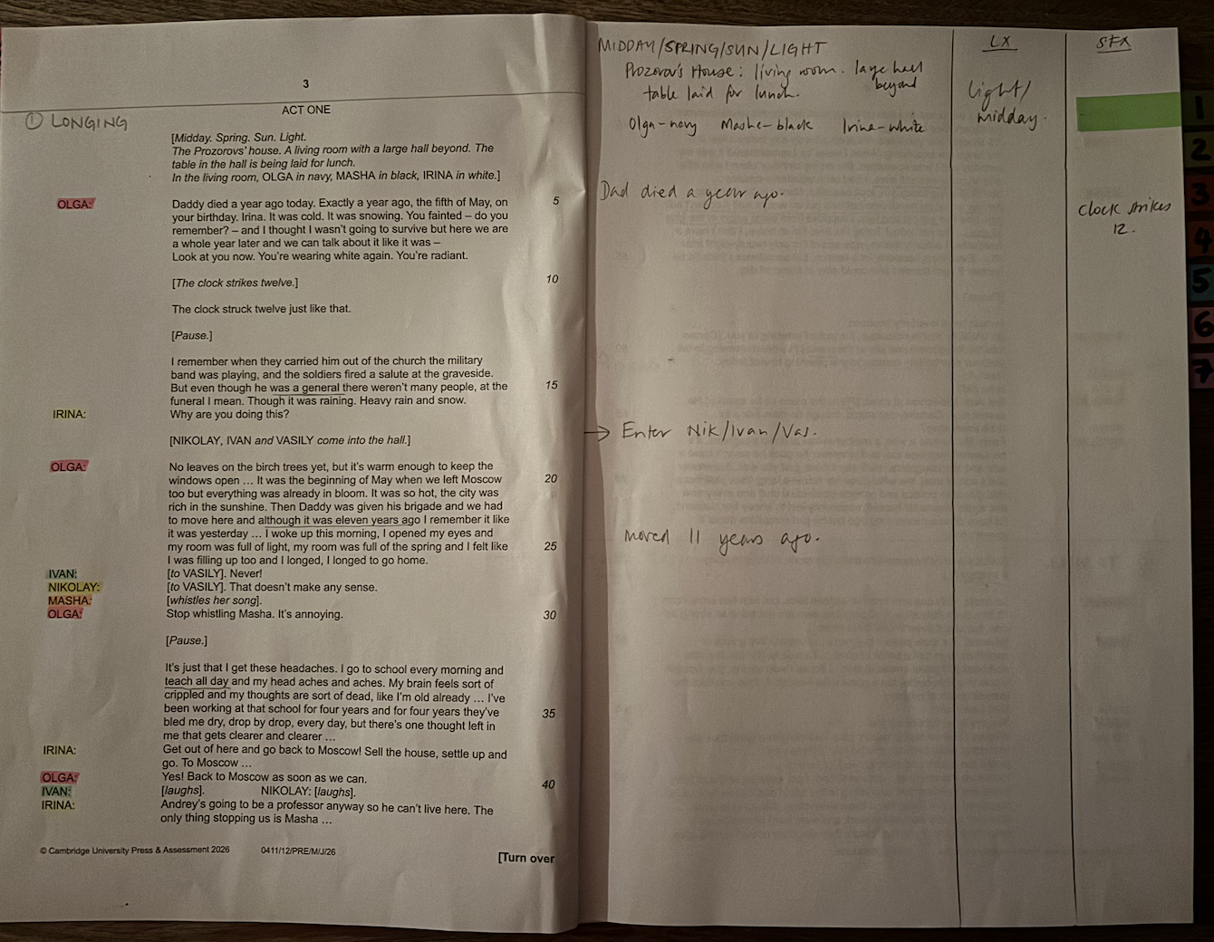
PREPARING YOUR SCRIPT
We print our script with a blank page next to each page for notes, diagrams for staging etc. We keep all notes in pencil so we can keep changing them as we go on.
On the front inside cover we use post-it notes to keep character notes. We can keep adding to these if needed.
TIPS FOR SCRIPT NOTES
Character Notes
Blank page for notes
© Jane Fisher

Slide 13

“I don’t imagine the wife of a banker will particularly choose to spend her evening in our kitchen.”
“Very much the lady of leisure, Mrs Brewster-Wright. Or so I would imagine”

Slide 14
“I trust by the end of this evening, we shall all be friends. Just don’t get nervous, that’s all.”
“You’re really expecting rather a lot tonight, aren’t you?”

Slide 15
“Oh dear oh dear. I’m terribly sorry.”
“I’ll tell you what, I could let you have a pair of my trousers from upstairs just while yours dry.”

Slide 16
“Isn’t this gorgeous? Isn’t this enchanting?”
“Just look at these working surfaces and you must have a gorgeous view from that window, I imagine.”

Slide 17
“Oh, that’s a washing machine. Tucked under there. How thrilling. What a marvellous Christmas present.”
“Enormous. Now you must tell me one thing, Mr Hopcroft. How on earth did you squeeze that machine so perfectly under the shelf?”

Slide 18
“Those curtains are really the most insistent colour I’ve ever seen. They must simply cry out to be drawn in the morning.”
“If you mean do they prevent me from turning into a raving lunatic, the answer is probably yes.”

Slide 19
“You’re looking at a mess. A wreck.”
“I mean, we’re all a bit mad. I’m a bit mad. Yes. It’s a mad world, as they say.”

Slide 20
“Extraordinary to think that one’s sanity can depend on these.”
“Don’t you sometimes long to be out of your body and free? Free just to float?”

Slide 21

This resource is a freebie from
www.the-understudy.org
It is designed to help you set up your scripts so that you will find working with our slides to explore this play much easier. And you will feel organised before you embark on your exploration.
The full set of resources are published over a series of dates as we write and publish as we go, due to the time constraints of receiving new material each September. For more details, go to:
https://www.the-understudy.org/igcsedramapre-release
© Jane Fisher

