Slide 2
Dear Teachers,
This is our freebie resource to introduce the second extracts of the Pre-Release Material for June 2025. We are trying a few new things this year. As I taught with our pre-release resources for the first time in the previous batch, I’ve identified ways I could make them more user-friendly and easier to navigate.
One thing we have introduced is a first read before the main practical exploration. This will mean that students have read the extract at least twice and will give them time to ‘digest’ the plot and characters, before coming to their practical work and written work. It will mean that when they do the practical work, they can draw on their knowledge of how the characters behave in the whole extract in order to shape their ideas. It worked really well for us on Extract 1, so if you haven’t tried it, maybe try this time. The play is short enough to be read in one quick sitting and then the context explorations will make so much more sense to them.
There is some guidance on the next slide for introducing the play using these slides. Then there are slides for various activities leading up to a first read and a few simple activities to help organise information. We find that students respond very well to having this kind of help with setting up their scripts and being organised - especially those who might usually be the kind to lose scripts, keep half-hearted notes. This is a great opportunity to teach skills of analysis and organisation of ideas. The fact that the extracts are only a few pages long means they can keep on top of it and feel successful.
Free Intro Materials: 3 Nov 2024
Teaching Pack 1 (Play 2 / Section B): 10 Nov
Teaching Pack 2 (Play 2 / Section B): 24 Nov
Exam Pack (Play 2 / Section B): 08 Dec
Kind regards,
Jane
© Jane Fisher

Slide 3
INTRO LESSON
Prepare the resources by printing out the image printouts below. Place them around your room.
Have students enter with music playing and investigate.
After a while, they can make some guesses about themes and ideas in the play. Can they guess at a plot?
Creative interpretations. Groups of 3-5. Create a piece of drama inspired by the images.
Students then read the quotes, ask them to think about what kind of person have said them or had them said about them. Gather feedback.
Students should create a frozen image of the character, then get them to walk around the space as the character, then ask them to pick a quote and give the character a voice. Spotlight some of the students work.
Repeat the above exercise with the second set of quotes.
Improvised scene. In pairs, students should improvise a scene between the two characters.
Share and discuss. What are they now curious about? What sense do they get of this world? This play?
Finally, students can begin preparing their scripts for use with The Understudy slides. We think it’s well worth their time to sit and highlight characters, divide their scripts into units and label each unit so they start the project organised and clear.
From here, we will be doing a first read together with some simple activities described in the later slides.
MUSIC OPTIONS
Forest Sounds | Woodland Ambience, Bird Song
Robin Hood (2010) Soundtrack - Fate Has Smiled Upon Us
Medieval England - Anon. 1225: Miri it is while sumer ilast

Slide 5
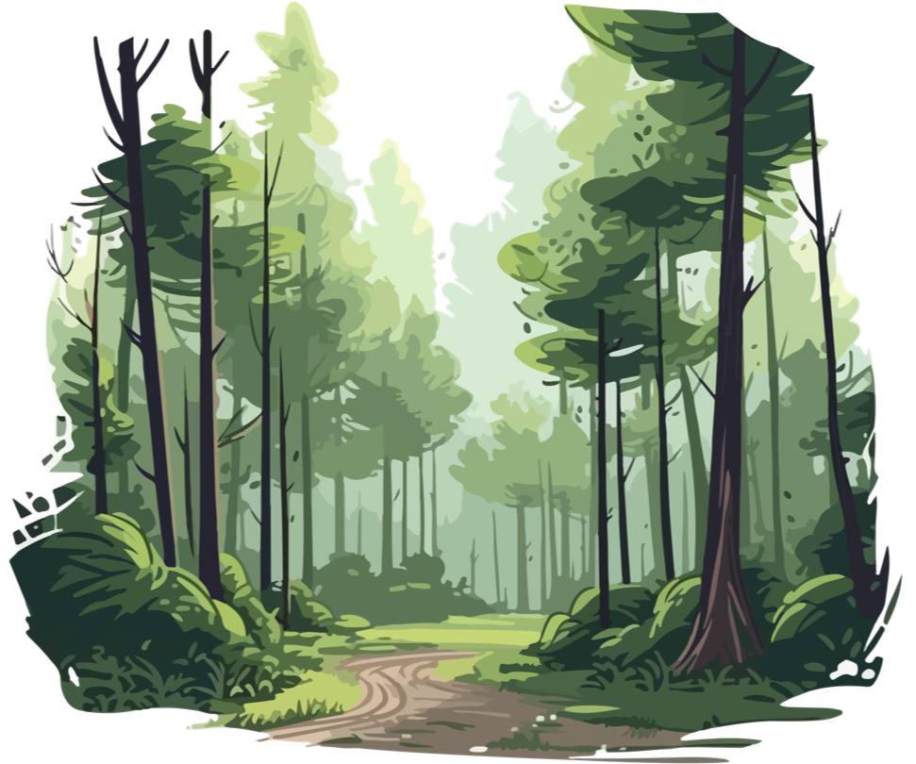

Slide 6
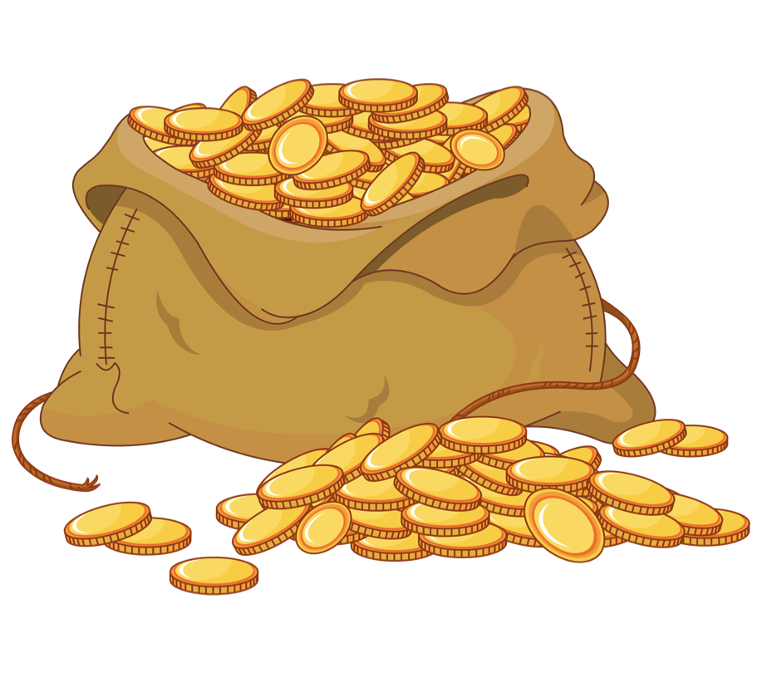

Slide 10
In groups of 3-5, create a piece of drama based on what you’ve seen so far. You don’t need to incorporate everything. Your piece can be realistic or stylised. It can be a scene or physical theatre or a mix. Text or no text. You can add music.

Slide 14
Share your work.
What have you become curious about?
What sense do you get of the world of this play based on today’s stimuli for exploration?

Slide 15
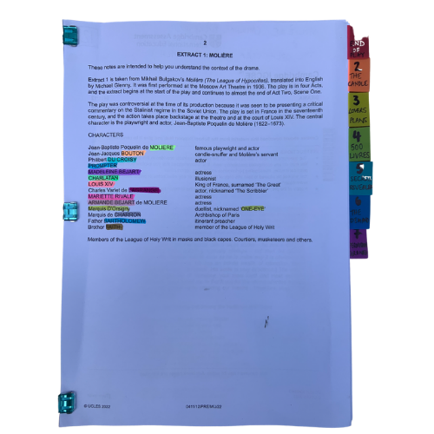
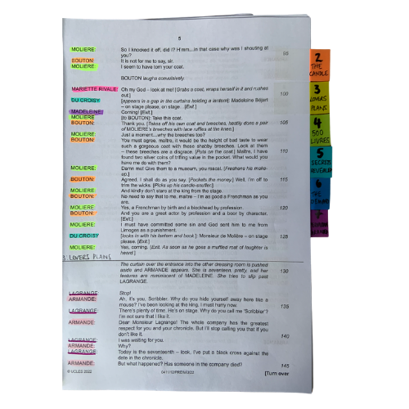
You will be working closely with this script for the next few months so get it organised, so you can access what you need easily, and you can easily see who is in a scene.
The extract has no labelled scene divisions so we’ve broken it into 5 units.
© Jane Fisher

Slide 16
Choosing a colour for each character and highlighting your whole script allows you to see who is in each scene and makes reading in class (or to yourself) and experimenting with scenes much easier. It also allows you to see how prominent a character is.
Adding tabs to mark each section makes finding your place easy and helps organise the script in your head.
Choosing a colour for each character and highlighting your whole script allows you to see who is in each scene and makes reading in class (or to yourself) and experimenting with scenes much easier. It also allows you to see how prominent a character is.
Adding tabs to mark each section makes finding your place easy and helps organise the script in your head.
© Jane Fisher

Slide 17
In drama analysis, directors and designers often break down the script into units. This makes it easier to analyse what is going on.
Different directors/designers use different ways to decide where a unit starts and ends. Often an entrance or exit of a character is useful as it means, characters intentions change. Each play is unique as is each decision about how to do this.
Different directors/designers use different ways to decide where a unit starts and ends. Often an entrance or exit of a character is useful as it means characters’ intentions change. Each play is unique as is each decision about how to do this.
We like to give each unit a name to help us remember it and to be able to talk about it with our class / company. We try to choose names that are simple and easy reminders of events.
UNIT | 1 | 2 | 3 | 4 | 5
PAGES | 15-16 | 16-19 | 19-20 | 21-22 | 22-23
LINES | 1-78 | 79-221 | 222-282 | 283-343 | 344-420
NAME | ROBIN HOOD | FRIENDSHIP & THIEVERY | THE LEGEND | THE KING OF THE FOREST | THE SHERIFF'S BIRTHDAY
© Jane Fisher

Slide 18
You can complete this document as a class or as individuals. You get deeper understanding and more attention to detail if you each do your own but you share ideas (and workload) if you do it together. Or you could each do your own then share and create a central document. It helps enormously with noticing details and understanding design requirements.
Here’s a blank template with just the first one done as an example
THE ADVENTURES OF ROBIN HOOD UNITS - BLANK.xlsx
© Jane Fisher

Slide 19
You can now read the script together and stop to complete your uniting document and begin a character study, so that when you come to do your second read and practical explorations, you know the characters and the plot of the whole extract and can draw on that knowledge in your activities and explorations of staging them. You can keep character notes on the second tab of the uniting sheets or you can keep notes in your script. See next slide.
© Jane Fisher

Slide 20
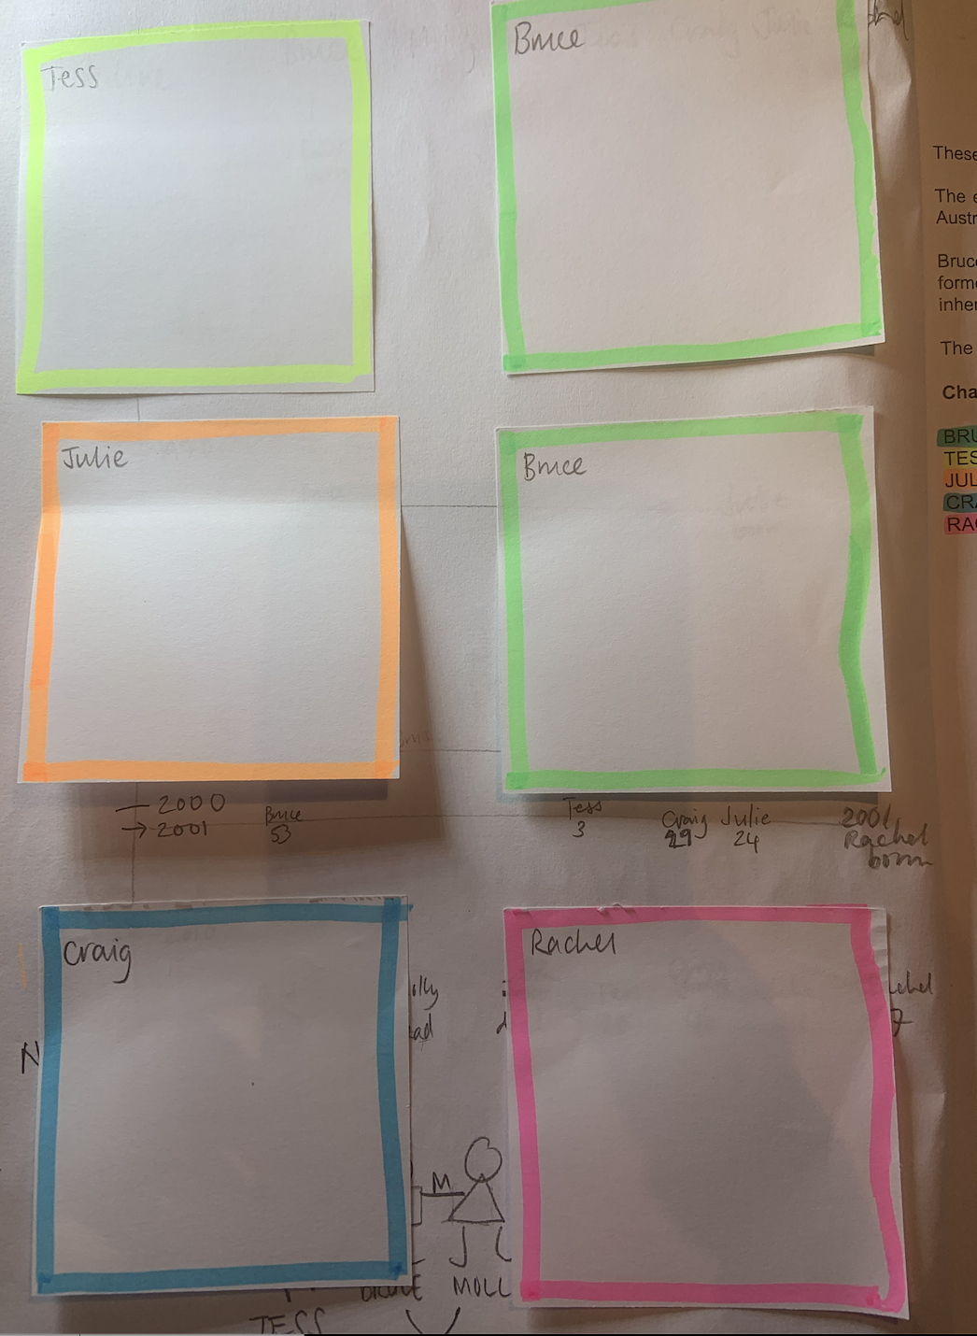
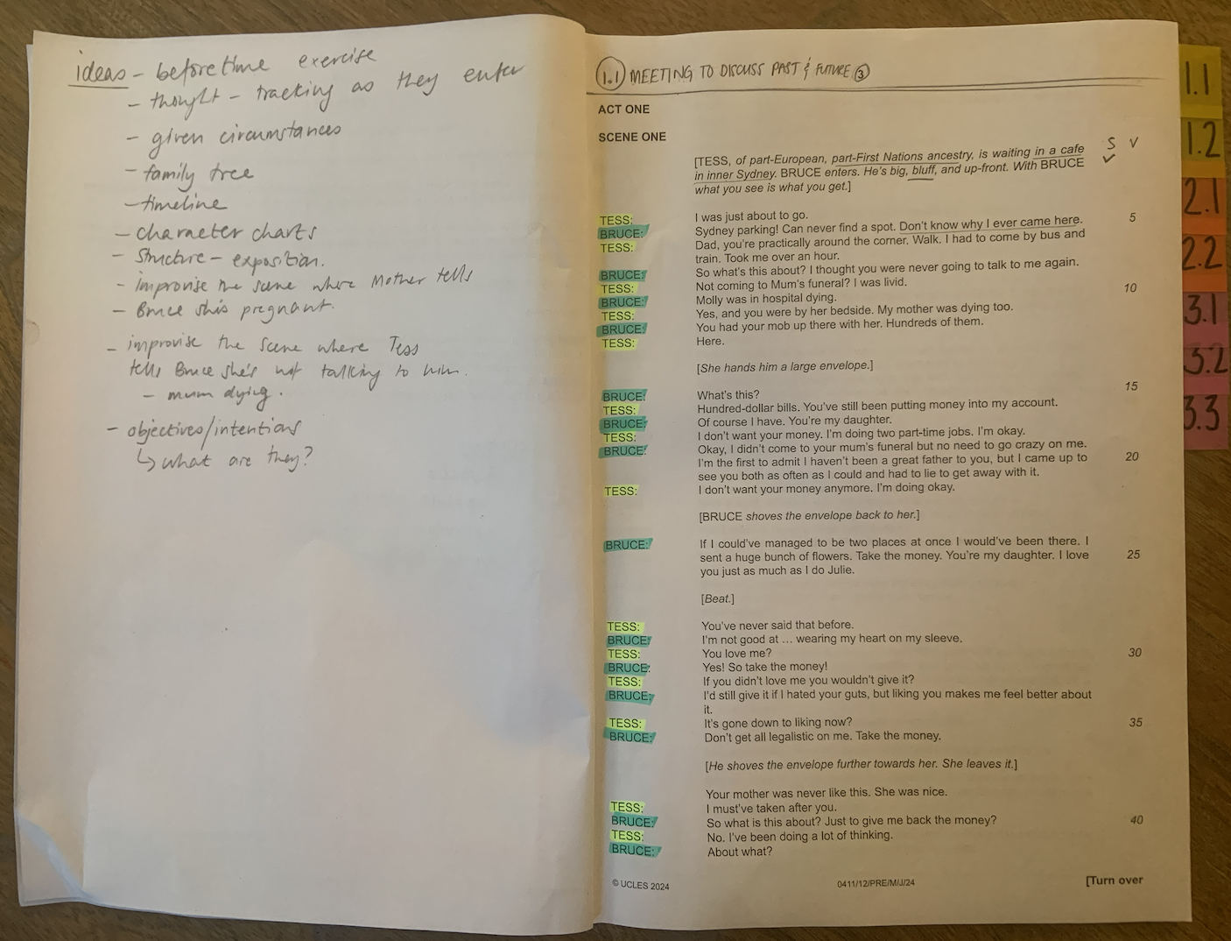
TIPS FOR SCRIPTS & NOTES
We print our script with a blank page next to each page for notes, diagrams for staging etc. We keep all notes in pencil so we can keep changing them as we go on. On the front inside cover we use post-it notes to keep character notes. We can keep adding to these if needed.
Character Notes
Blank page for notes
© Jane Fisher

Slide 21
This resource is a freebie from
www.the-understudy.org
It is designed to help you set up your scripts so that you will find working with our slides to explore this play much easier. And you will feel organised before you embark on your exploration.
The full set of resources are published over a series of dates as we write and publish as we go, due to the time constraints of receiving new material each September. For more details, go to:
https://www.the-understudy.org/igcsedramapre-release
© Jane Fisher

