Slide 1


FREE PRE-READING ACTIVITIES

Slide 2


A NOTE
In case this is your first time with us…
This resource is designed in a hurry to get out fast for those who want to get started, while we work on the actual teaching resources that we design more carefully and professionally.
Just so you know…

Slide 3
Dear Teachers,
This is our freebie resource to introduce the first extracts of the Pre-Release Material for May/June 2026.
We like reading the extract before starting the practical exploration to get a first sense of the play. It means that students have read the extract and gives them time to ‘digest’ the plot and characters, before coming to their practical work and written work. It also means that when they do the practical work, they can draw on their knowledge of how the characters behave in the whole extract in order to shape their ideas.
There is some guidance on the next slide for introducing the play using these slides. Then there are slides for various activities leading up to a first read and a few simple activities to help organise information. We find that students respond very well to having this kind of help with setting up their scripts and being organised - especially those who might usually be the kind to lose scripts, keep half-hearted notes. This is a great opportunity to teach skills of analysis and organisation of ideas. The fact that the extracts are only 15 pages or so means they can keep on top of it and feel successful.
The first set of slides for practical exploration is due out on or before 14 September.
If you would like to pre-order (especially if you need to pay via a bank transfer from school)
you can do so in the shop: www.the-understudy.org/shop.
Just choose ‘manual payment’ at check out in order to generate an invoice.
Otherwise you can buy an instant download as soon as they are published.
Kind regards,
Jane
© Jane Fisher

Slide 4
Teacher notes
INTRODUCTORY LESSON
INTRODUCTORY LESSON
We love to start with a fun introductory lesson before students have any knowledge of the play. It gets them excited about the play and ignites curiosity.
Print out the images and quotes at the end of these slides and put them around your room. (If you have the props, you could put these out instead: luggage, money, map, flowers, book.)
If you have lighting, maybe make it feel like 2am in 1904. Blue wash, lanterns / candles etc.
Play some Russian folk music. (https://www.youtube.com/watch?v=PlD84j7DcJU&t=1s)
Invite students in to wander around and explore.
What sense do they get of the world of the play? What are they curious about?
Get them each to choose one of the quotes, try to make meaning and create a
naturalistic interpretation of it.
They must then get into small groups (probably 2/3)
and create a scene with all their quotes in it
(slide to project next).
There are 10 quotes so if your class is bigger, more than one student can have the same quote. Make sure they are in different groups. It will be interesting to see what different students do with the same quote.

Slide 5
EXPLORE THE ROOM
What sense do you get of this world?
What are you curious about?

Slide 6
CHOOSE A QUOTE
You can have the same quote as someone else.
Can you make it make sense?
Decide what it is about.
Experiment with speaking the lines in a way that feels naturalistic - try not to perform! Try to make sense of the lines.
Share around the room.

Slide 7

Student
Task
DEVISE A SCENE
Try not to play the scene for laughs. There may be some comic elements but you should not play up to it. Don’t let it dominate the scene.
Work in groups of 2 or 3.
Share your quotes with each other
and discuss what they might mean.
Create a scene which:
- must be set at 2 o’clock on a cold morning
- must be very naturalistic
- must be set inside a house
- must include at least one of quotes your group has chosen
Remember that we are looking for naturalism
in one single scene, not silly plots designed to
get the quotes in. How can you work hard to make
meaning and make sense and make us
believe in your characters and their situation?

Slide 8
Student
Task
SHARE & REFLECT
“They’ve got all that luggage to sort out.”
Share your scenes and discuss any emerging themes and ideas.
What did the quotes inspire?

Slide 9
A NOTE FOR TEACHERS
The next exercise is fairly sophisticated so decide whether it’s a good idea for your class or not. If it will lead to them writing weird answers vaguely referencing ‘layers of nature’ at some stage later down the line, it may not be a good idea.
If they are capable and bright and you lead them carefully through it and manage their understanding, it will be excellent preparation for studying the play.
But even then, you will need to be careful that vague remnants of it don’t creep into answers in unhelpful ways later down the line.
Be clear that most written answers expect students to explain what they would do on stage, not what their preparation was - but these exercises can help us to prepare roles with creativity, sensitivity and imagination, which will hopefully lead to better written answers.

Slide 10

Student
Task
KATIE MITCHELL
Watch the first eleven minutes of this video about Katie Mitchell’s approach to Naturalism.
00:00 - 11:00
NATURALISM EXERCISE
www.nationaltheatre.org.uk/learn-explore/schools/teacher-resources/practitioners-in-practice-katie-mitchell-film/
Discuss Mitchell’s 6 layers of Naturalism.
Can you remember what they were and explain them to each other?

Slide 11
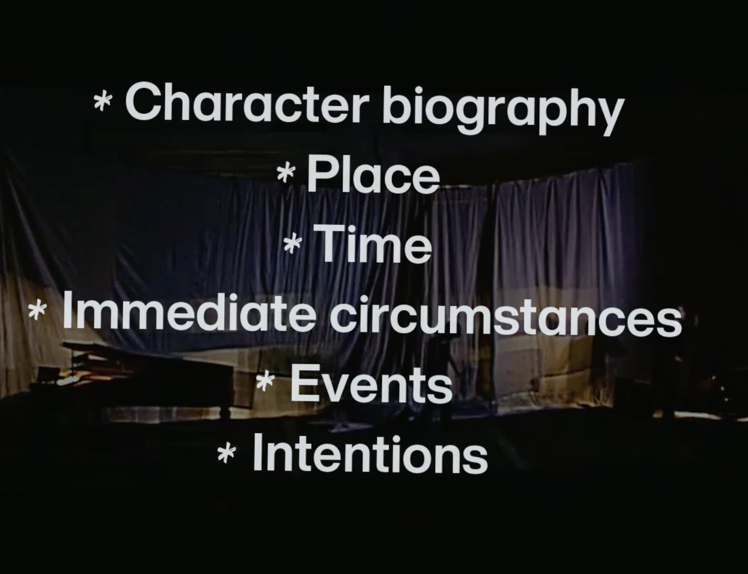
Student
Task
KATIE MITCHELL
Try the exercise that Katie Mitchell did exactly as she did with one actor.
PRACTICAL EXERCISE
You can decide whether to have the teacher lead and all observe one actor, or split into pairs with one actor and one director to lead them through the exercise.

Slide 12
Student
Task
KATIE MITCHELL
AND/OR
Try the exercise that Katie Mitchell did exactly as she did with one actor walking into a room.
PRACTICAL EXERCISE
Character biography: The incidents in a character’s past which create their behaviour in the present.
You are a middle aged woman, who owns a lot of land but you can’t afford its upkeep and are in a lot of debt. You refuse to acknowledge this and still live a ‘champagne lifestyle’. You left home ten years ago to recover from your husband and son’s death. You spent all your money in Paris on a lover who treated you badly.

Slide 13
Student
Task
KATIE MITCHELL
AND/OR
Try the exercise that Katie Mitchell did exactly as she did with one actor walking into a room.
PRACTICAL EXERCISE
Place: The location where the action of the scene happens.
You are walking into your home for the first time in 10 years.

Slide 14
Student
Task
KATIE MITCHELL
AND/OR
Try the exercise that Katie Mitchell did exactly as she did with one actor walking into a room.
PRACTICAL EXERCISE
Time: The year, season, day of the week and time of day the scene takes place in.
It is a frosty morning at 2am.

Slide 15
Student
Task
KATIE MITCHELL
AND/OR
Try the exercise that Katie Mitchell did exactly as she did with one actor walking into a room.
PRACTICAL EXERCISE
Immediate circumstances: The incidents that happen in the 24 hours before the scene starts that affect the character’s mood and behaviour.
You have travelled all night on the train. It is more than 2 hours later than expected.

Slide 16
Student
Task
KATIE MITCHELL
AND/OR
Try the exercise that Katie Mitchell did exactly as she did with one actor walking into a room.
PRACTICAL EXERCISE
Events: The changes in the scene that affect the thoughts, feelings or actions of all the characters.
The room is filled with people from your past life here on your estate, who know how little money you have.

Slide 17
Student
Task
KATIE MITCHELL
AND/OR
Try the exercise that Katie Mitchell did exactly as she did with one actor walking into a room.
PRACTICAL EXERCISE
Intentions: What the character wants the other character(s) to do, feel or say.
You want to make everyone in the room see how well you are doing and how happy you are.

Slide 18
KATIE MITCHELL’S SIX LAYERS OF NATURALISM
Character biography: The incidents in a character’s past which create their behaviour in the present.
Place: The location where the action of the scene happens.
Time: The year, season, day of the week and time of day the scene takes place in.
Immediate circumstances: The incidents that happen in the 24 hours before the scene starts that affect the character’s mood and behaviour.
Events: The changes in the scene that affect the thoughts, feelings or actions of all the characters.
Intentions: What the character wants the other character(s) to do, feel or say.
Now see if you can go back to your scene you created and apply these six layers. If this is too challenging to do in groups, perhaps the whole class can work on one scene, making offers and suggestions while just the 2/3 people play the scene.
You want to comfort and celebrate your sister - to make her feel good.

Slide 19
Student
Task
SHARE & REFLECT
“I saw. I know.”
How has this exercise helped develop your understanding of a naturalistic style of acting?
What are you curious about in terms of the play we are about to study based on everything you have experienced today?

Slide 20
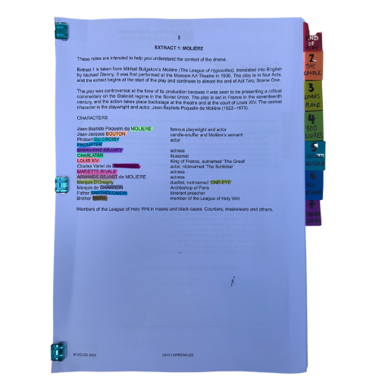
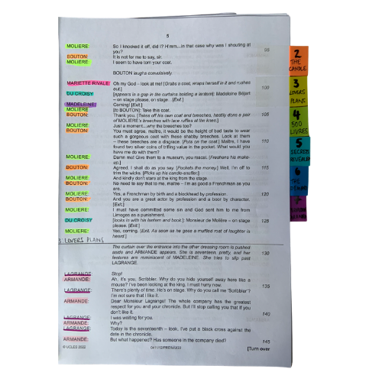


PREPARING YOUR SCRIPT
You will be working closely with this script for the next few months so get it organised, so you can access what you need easily, and you can easily see who is in a scene.
The script is two scenes. We’ve broken those down into seven units for our learning.
© Jane Fisher

Slide 21

PREPARING YOUR SCRIPT
Choosing a colour for each character and highlighting your whole script allows you to see who is in each scene and makes reading in class (or to yourself) and experimenting with scenes much easier. It also allows you to see how prominent a character is.
Adding tabs to mark each section makes finding your place easy and helps organise the script in your head.
© Jane Fisher

Slide 22

Different directors/designers use different ways to decide where a unit starts and ends. Often an entrance or exit of a character is useful as it means characters’ intentions change. Each play is unique as is each decision about how to do this.
In drama analysis, directors and designers often break down the script into units. This makes it easier to analyse what is going on.
We like to give each unit a name to help us remember it and to be able to talk about it with our class / company. We try to choose names that are simple and easy reminders of events.
UNIT | 1 | 2 | 3 | 4 | 5 | 6 | 7
PAGES | 3 | 4 | 4-6 | 6-8 | 8-10 | 10-11 | 11-13
LINES | 1-46 | 47-87 | 88-137 | 138-242 | 243-305 | 306-393 | 394-467
NAME | ANTICIPATION | LOVESICK | ARRIVAL | TALK OF TRAVEL | HOME | THE PLAN | ULTIMATUM
© Jane Fisher

Slide 23
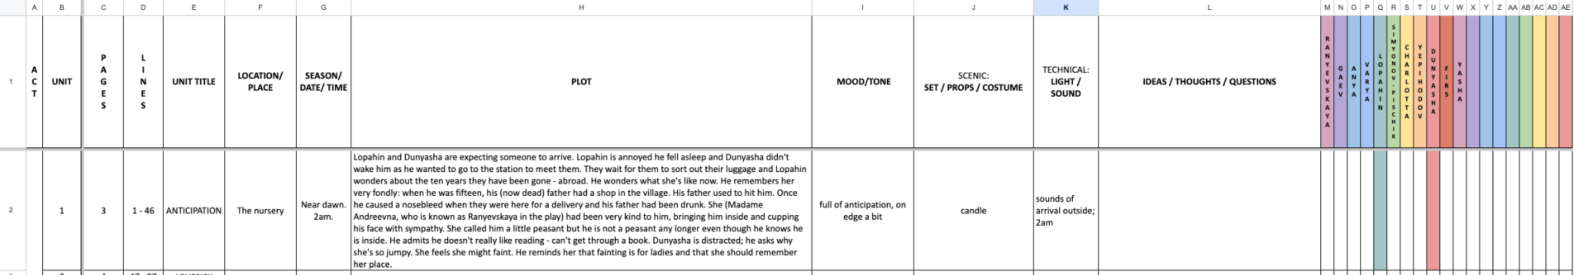
You can complete this document as a class or as individuals. You get deeper understanding and more attention to detail if you each do your own but you share ideas (and workload) if you do it together. Or you could each do your own then share and create a central document. It helps enormously with noticing details and understanding design requirements.
Here’s a blank template with just the first one done as an example
BLANK THE CHERRY ORCHARD UNITS.xlsx
© Jane Fisher

Slide 24

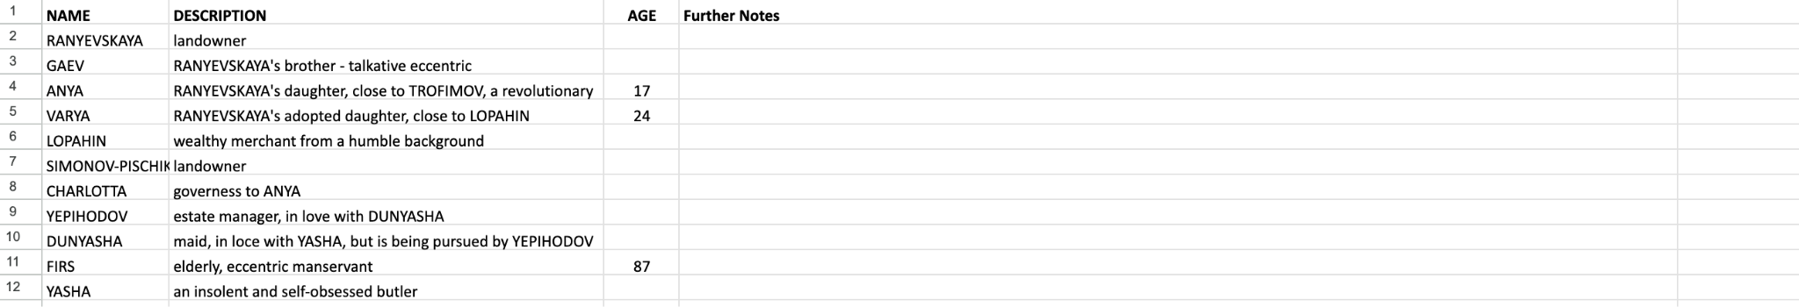
READ THE SCRIPT TOGETHER
You can now read the script together and stop to complete your uniting document and begin a character study, so that when you come to do your second read and practical explorations, you know the characters and the plot of the whole extract and can draw on that knowledge in your activities and explorations of staging them. You can keep character notes on the second tab of the uniting sheets or you can keep notes in your script. (See next slide.)
© Jane Fisher

Slide 25
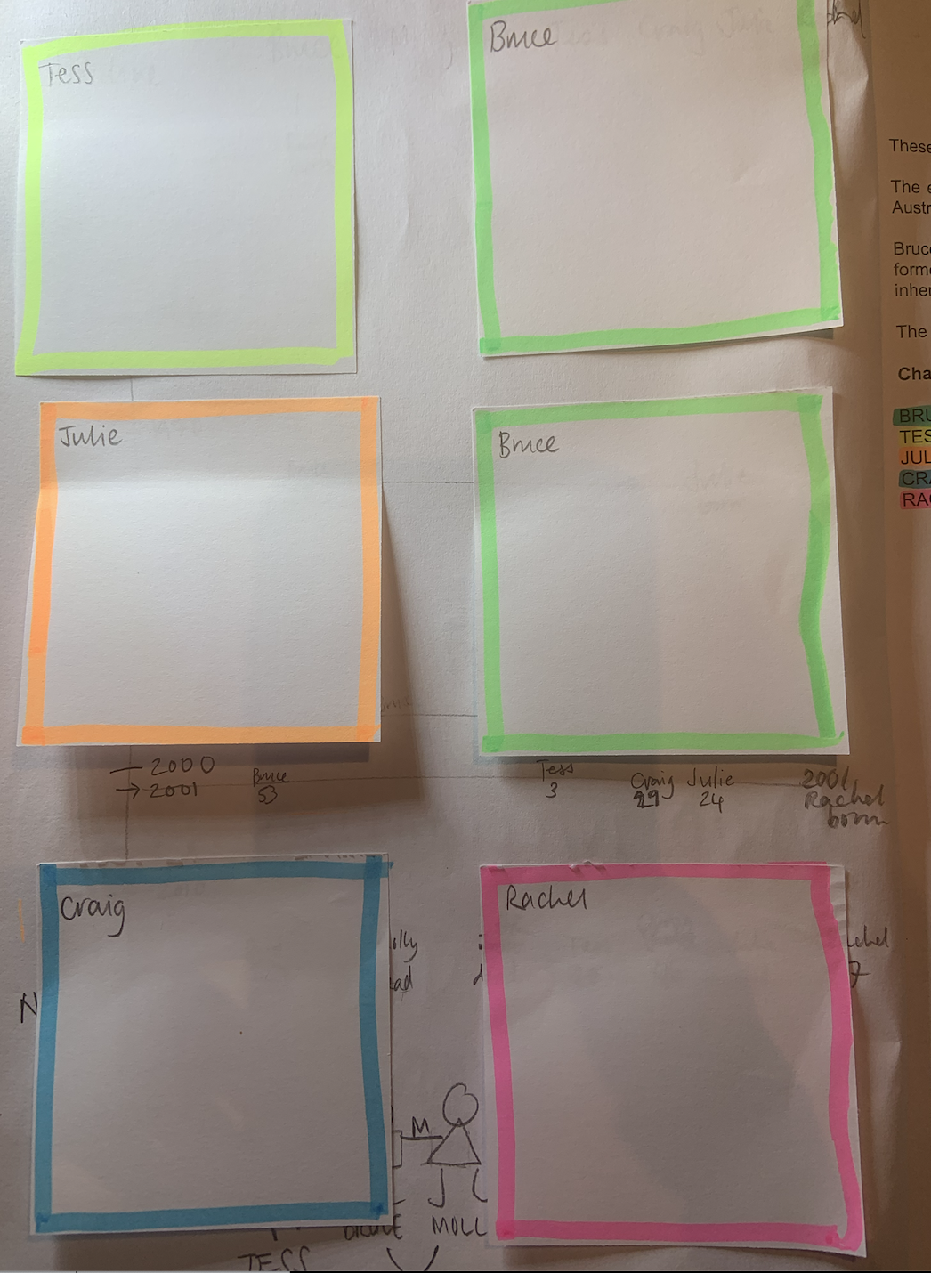
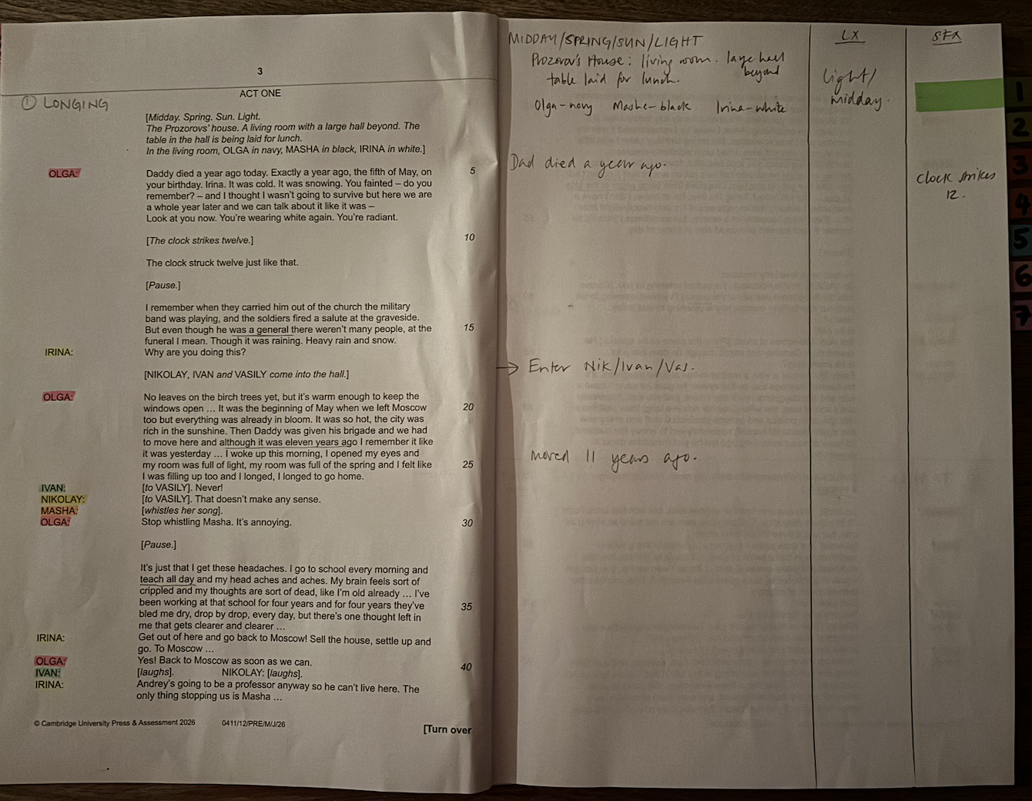
We print our script with a blank page next to each page for notes, diagrams for staging etc. We keep all notes in pencil so we can keep changing them as we go on.
On the front inside cover we use post-it notes to keep character notes. We can keep adding to these if needed.
TIPS FOR SCRIPT NOTES
Character Notes
Blank page for notes
© Jane Fisher

Slide 26
MAKE A FAMILY TREE
After (or during) your first reading, create a quick “family tree”, showing all the characters in the play and their relationships. To each other and to others mentioned.
Include spouses and others who are mentioned in the play so you can keep a tab on who is married, divorced, related, in love, servant, master etc.
Find the best way to represent the web of relationships that are portrayed in the play.
Extension: pick a quote that shows something about the relationship.
These do not need to be neat and pretty diagrams: a quick pencil sketch will do the job that you need it to. It’s to help you to understand the relationships and history. It’s the act of doing it that is the learning. Maybe use the colours you’ve been using for highlighting. This is especially useful for this play with lot of characters.
© Jane Fisher

Slide 27

“I was suddenly just sorry for her. I could see her stranded in the corner. I hugged her, squeezed her to me and couldn’t let her go.”

Slide 28
“We sit down to lunch and she orders the most expensive thing on the menu. And champagne. And a tip for the waiters…”

Slide 29
“He loves me desperately as far as I can tell.”

Slide 30
“I can’t believe - it’s like I take a breath and here I am, suddenly fifty.”

Slide 31
“Things are changing.
Mark my words.”

Slide 32
“You decide. You decide. You all. Decide. But I’ve got a plan and I can’t see any other way out.”

Slide 33
“This whole area might support a new type of community. It may be the future. Happy, rich, grand.”

Slide 34
“She had to leave, I know why now. I saw something in Paris. I understood her. She couldn't stay on with Grisha drowned.”

Slide 35
“I saw the forgiveness she craves.”

Slide 36
“We don’t need all the past at once. Do we?”

Slide 37


Slide 38


Slide 39


Slide 40


Slide 41


Slide 42
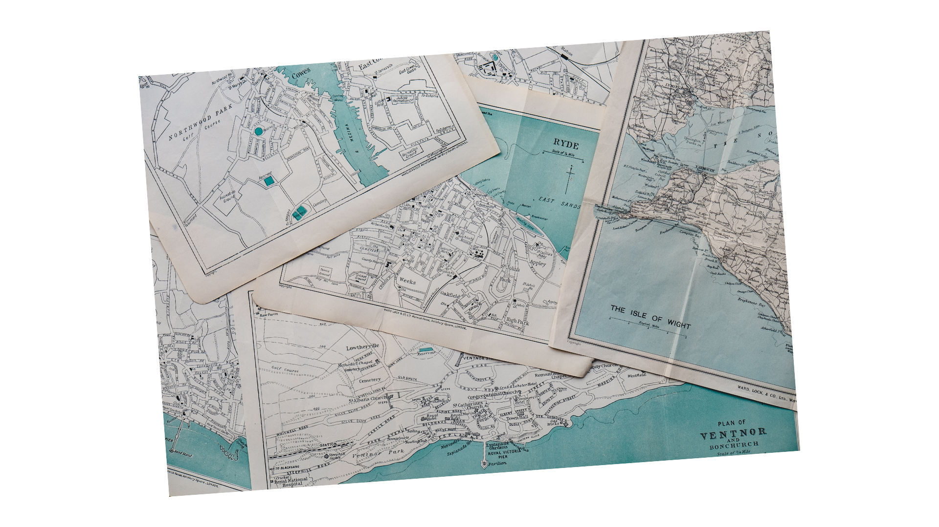

Slide 43

This resource is a freebie from
www.the-understudy.org
It is designed to help you set up your scripts so that you will find working with our slides to explore this play much easier. And you will feel organised before you embark on your exploration.
The full set of resources are published over a series of dates as we write and publish as we go, due to the time constraints of receiving new material each September. For more details, go to:
https://www.the-understudy.org/igcsedramapre-release
© Jane Fisher

