Slide 2
Dear Teachers,
This is our freebie resource to introduce the first extracts of the Pre-Release Material for June 2025.
Last year we tried reading the extract before starting the practical exploration and this worked well. It means that students have read the extract at least twice and gives them time to ‘digest’ the plot and characters, before coming to their practical work and written work. It means that when they do the practical work, they can draw on their knowledge of how the characters behave in the whole extract in order to shape their ideas.
There is some guidance on the next slide for introducing the play using these slides. Then there are slides for various activities leading up to a first read and a few simple activities to help organise information. We find that students respond very well to having this kind of help with setting up their scripts and being organised - especially those who might usually be the kind to lose scripts, keep half-hearted notes. This is a great opportunity to teach skills of analysis and organisation of ideas. The fact that the extracts are only 15 pages or less means they can keep on top of it and feel successful.
The first set of slides for practical exploration is due out on or before 15 September.
We expect it might be a little earlier, but don’t want to make promises we can’t keep.
If you would like to pre-order (especially if you need to pay via a bank transfer from school) you can do so in the shop: www.the-understudy.org/shop
Otherwise you can buy an instant download as soon as they are published. Kind regards,
Jane
© Jane Fisher

Slide 3
We love to introduce the play with a fun lesson so go to a bit of extra effort to get the students excited and engaged. You can do this lesson without all the props if you don’t have them / don’t have time.
INTRO LESSON
Set up your space with as many of the following props / set items as you can make available: table with tablecloth (smart); flowers; wine glasses; napkins; candles. If you have a separate couch and coffee table, you could add that into your set and adorn it with flowers and a bowl of snacks (crisps / crackers). Add dip if you want to be really fancy. Add as many things to your set that you can to give it a 1960s feeling if you a props store. Rotary phone? Record player? Taking inspiration from the play, have a roasting pan with something that represents the burnt meat (bundled up black bag?) available too.
You could add music for when students enter. it's the 1960s and you're in love
or an NYC soundscape Open Window Times Square, New York City Soundscape for Work/Study (Night to Sunrise) 12 Hours
Add lighting if you have it available.
Ask them to infer information from the set. What can they learn?
© Jane Fisher

Slide 4
5. Use Slides 5 and 6 to devise some comical scenes inspired by the extract. Depending on the size of your class, you could let them choose which scene to do or all do both.
6. Use slide 7 to lead a discussion about the nature of comedy.
7. Have students look at slide 8. See if they can identify two different characters from the quotes. You can also use the printable version on slide 9 so they can physically sort them. (Answers on Slide 10.) What do they notice about each character? (They may expect Felix to be a woman due to preconceived ideas about domestic relationships.)
9. Divide them into two halves then get each half to split up the quotes between them. They should rehearse it with vocal expression, facial expression and movement or gesture. Students can perform this as a whole class performance, have them stand in a space and one at a time deliver their line with their movement or gesture. What do they notice about each character?
10. Finally, students can begin preparing their scripts for use with The Understudy slides. We think it’s well worth their time to sit and highlight characters, divide their scripts into units and label each unit so they start the project organised and clear.
11. From here, you can move into a first read with a focus on enjoying the script, making observations about the characters and maybe taking some notes on characters.
slides.
INTRO LESSON CONTINUED

Slide 5
“AWKWARD FIRST DATE GOES WRONG”
In groups of 4, devise a scene which depicts a double date that goes wrong. It should be very awkward at the start and the evening should descend into worse and worse things happening.
Everyone might end in tears… but your are aiming for a comical tone.
You should set it in a home (unless you have odd numbers and need a waitress in one group).

Slide 6
“WE JUST WANNA PLAY CARDS, MAN”
In groups of 4(ish), devise another scene in which a group of men is trying to play their Friday night card game, but one of them insists on hosting with unexpected elegance. He is waiting on the others, cleaning everything they put down, asking them to use coasters, clearing their crumbs, providing gourmet food that he describes like a restaurant menu. The other men may respond in various ways: some enjoying the food and attention, others irritated and wanting to play and just have their usual kind of game.

Slide 7
What were the elements in each piece created the humour?
What makes situations like this funny?
Are there differences in how we might create and/or perceive scenes like this in today’s world versus the 1960s? What has changed?
Is comedy / humour universal and/or timeless?

Slide 8
“Don’t bother me with your petty little problems. You get this one stinkin’ night a week.”
“Your coaster. The little round thing that goes under the glass. Always try to use your coaster, fellows. I hate to be a pest but you know what wet glasses do.”
“I just want to get one thing clear. This is the last time I ever cook for you. Because people like you don’t even appreciate a decent meal. That’s why they have T.V. Dinners.”
“Look, take whoever you want. When they come to the door, point to the sister of your choice. I don’t care. I just want to have some laughs.”
“Wait a minute. I want to get this down on a tape recorder… because no one’ll believe me!...You mean now I have to call you if I’m coming late for dinner?”
Can you arrange these quotes into two characters?
What can we infer about each character?
“All I want to do is have dinner with a couple of girls. You just have to eat and talk. It’s not hard. You’ve eaten and talked before.”
“I’ll tell you the difference. You told me they were coming at seven-thirty. You were going to be here at seven to help me with the hor d'oeuvres.”
(Cleaning) “I intend to go out. I get lonely too. But I’m just separated a few weeks. Give me a little time.”

Slide 9
“Your coaster. The little round thing that goes under the glass. Always try to use your coaster, fellows. I hate to be a pest but you know what wet glasses do.”
“Don’t bother me with your petty little problems. You get this one stinkin’ night a week.”
“I just want to get one thing clear. This is the last time I ever cook for you. Because people like you don’t even appreciate a decent meal. That’s why they have T.V. Dinners.”
“I’ll tell you the difference. You told me they were coming at seven-thirty. You were going to be here at seven to help me with the hor d'oeuvres.”
Printable Version
(Cleaning) “I intend to go out. I get lonely too. But I’m just separated a few weeks. Give me a little time.”
Can you arrange these quotes into two characters?
What can we infer about each character?
“Look, take whoever you want. When they come to the door, point to the sister of your choice. I don’t care. I just want to have some laughs.”
“All I want to do is have dinner with a couple of girls. You just have to eat and talk. It’s not hard. You’ve eaten and talked before.”
“Wait a minute. I want to get this down on a tape recorder… because no one’ll believe me!...You mean now I have to call you if I’m coming late for dinner?”

Slide 10
“Don’t bother me with your petty little problems. You get this one stinkin’ night a week.”
“Your coaster. The little round thing that goes under the glass. Always try to use your coaster, fellows. I hate to be a pest but you know what wet glasses do.”
“I just want to get one thing clear. This is the last time I ever cook for you. Because people like you don’t even appreciate a decent meal. That’s why they have T.V. Dinners.”
(Cleaning) “I intend to go out. I get lonely too. But I’m just separated a few weeks. Give me a little time.”
“All I want to do is have dinner with a couple of girls. You just have to eat and talk. It’s not hard. You’ve eaten and talked before.”
Split the class in half so half take Oscar and half take Felix. Then split up the lines amongst your group. Each rehearse a little performance of your line using vocal expression, facial expression, gesture, movement.
Share your work.
“Look, take whoever you want. When they come to the door, point to the sister of your choice. I don’t care. I just want to have some laughs.”
“I’ll tell you the difference. You told me they were coming at seven-thirty. You were going to be here at seven to help me with the hor d'oeuvres.”
“Wait a minute. I want to get this down on a tape recorder… because no one’ll believe me!...You mean now I have to call you if I’m coming late for dinner?”
WHAT DO WE NOTICE ABOUT EACH CHARACTER?

Slide 11
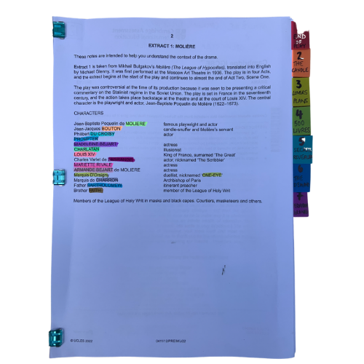
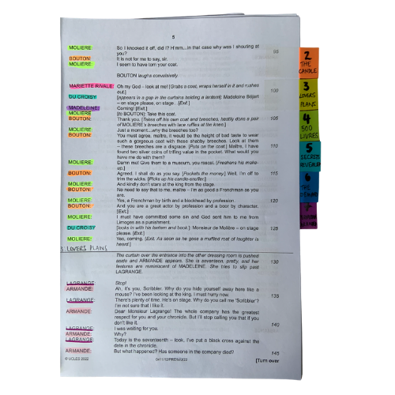
You will be working closely with this script for the next few months so get it organised, so you can access what you need easily, and you can easily see who is in a scene.
The script is two scenes. We’ve broken those down into seven units for our learning.
© Jane Fisher

Slide 12
Choosing a colour for each character and highlighting your whole script allows you to see who is in each scene and makes reading in class (or to yourself) and experimenting with scenes much easier. It also allows you to see how prominent a character is.
Adding tabs to mark each section makes finding your place easy and helps organise the script in your head.
Choosing a colour for each character and highlighting your whole script allows you to see who is in each scene and makes reading in class (or to yourself) and experimenting with scenes much easier. It also allows you to see how prominent a character is.
Adding tabs to mark each section makes finding your place easy and helps organise the script in your head.
© Jane Fisher

Slide 13
In drama analysis, directors and designers often break down the script into units. This makes it easier to analyse what is going on.
Different directors/designers use different ways to decide where a unit starts and ends. Often an entrance or exit of a character is useful as it means, characters intentions change. Each play is unique as is each decision about how to do this.
Different directors/designers use different ways to decide where a unit starts and ends. Often an entrance or exit of a character is useful as it means characters’ intentions change. Each play is unique as is each decision about how to do this.
We like to give each unit a name to help us remember it and to be able to talk about it with our class / company. We try to choose names that are simple and easy reminders of events.
UNIT | 1.1 | 1.2 | 2.1 | 2.2 | 2.3 | 2.4 | 2.4
PAGES | 3-5 | 5-7 | 7-9 | 9-10 | 10-12 | 12-13 | 13-14
LINES | 1-138 | 139-242 | 243-330 | 395-460 | 395-460 | 460-538 | 539-607
NAME | CARDS | PLANNING THE DATE | 8 IS LATE! | ARRIVAL | AWKWARD SMALL TALK | TEARS | BURNT
© Jane Fisher

Slide 14
You can complete this document as a class or as individuals. You get deeper understanding and more attention to detail if you each do your own but you share ideas (and workload) if you do it together. Or you could each do your own then share and create a central document. It helps enormously with noticing details and understanding design requirements.
Here’s a blank template with just the first one done as an example
THE ODD COUPLE UNITS BLANK.xlsx
© Jane Fisher

Slide 15
You can now read the script together and stop to complete your uniting document and begin a character study, so that when you come to do your second read and practical explorations, you know the characters and the plot of the whole extract and can draw on that knowledge in your activities and explorations of staging them. You can keep character notes on the second tab of the uniting sheets or you can keep notes in your script. See next slide.
© Jane Fisher

Slide 16
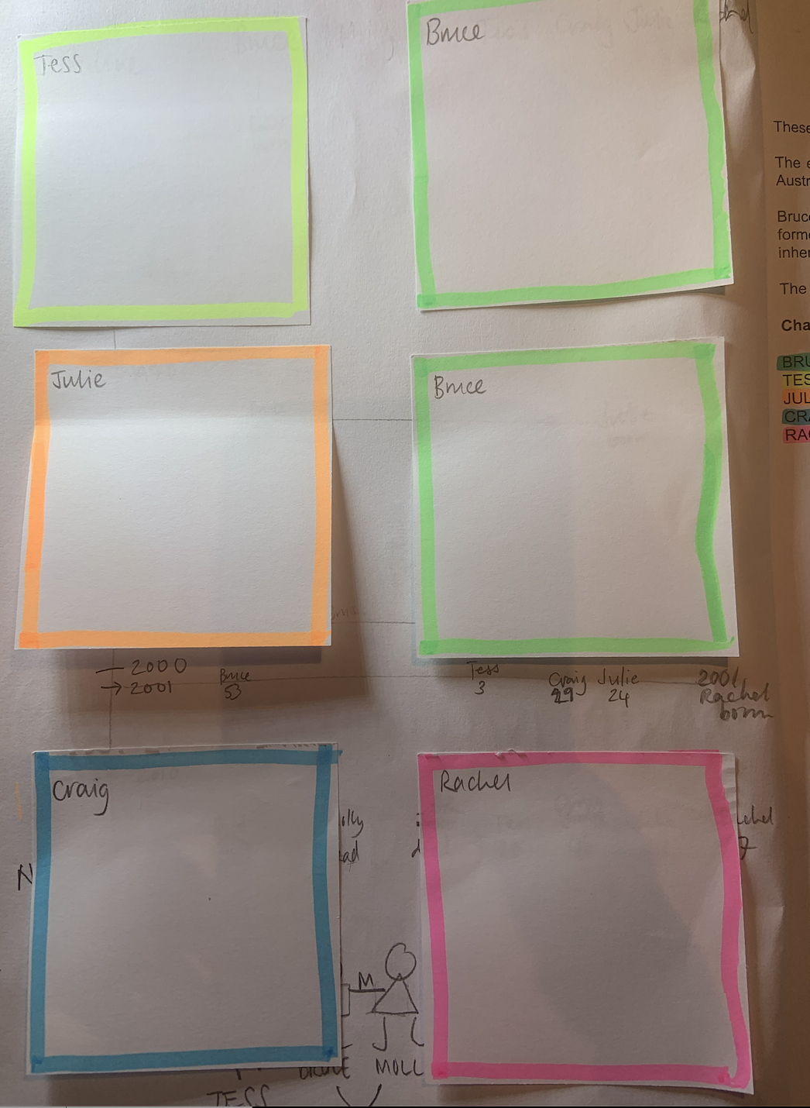
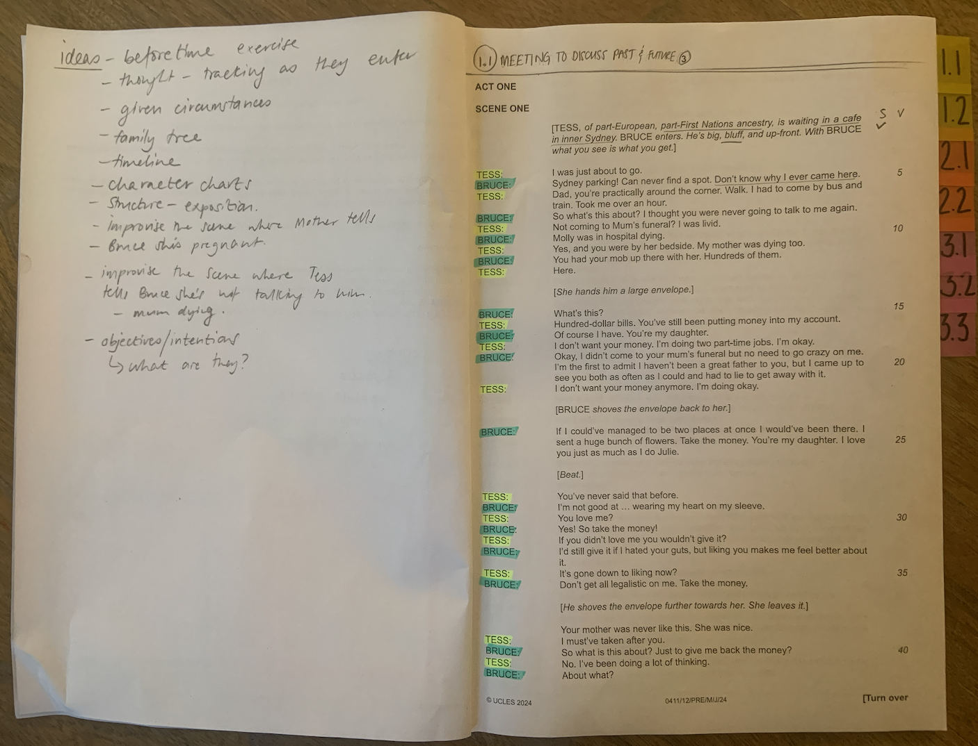
TIPS FOR SCRIPTS & NOTES
We print our script with a blank page next to each page for notes, diagrams for staging etc. We keep all notes in pencil so we can keep changing them as we go on. On the front inside cover we use post-it notes to keep character notes. We can keep adding to these if needed.
Character Notes
Blank page for notes
© Jane Fisher

Slide 17
These do not need to be neat and pretty diagrams: a quick pencil sketch will do the job that you need it to. It’s to help you to understand the relationships and history. It’s the act of doing it that is the learning. Maybe use the colours you’ve been using for highlighting.
(sort of)
After reading, create a quick “family tree”, showing all the characters in the play and their relationships. To each other and to others mentioned.
Include spouses and exes who are mentioned in the play so you can keep a tab on who is married, divorced, widowed etc.
Find the best way to represent the web of relationships that are portrayed in the play.
Extension: pick a quote that shows something about the relationship.
© Jane Fisher

Slide 18
This resource is a freebie from
www.the-understudy.org
It is designed to help you set up your scripts so that you will find working with our slides to explore this play much easier. And you will feel organised before you embark on your exploration.
The full set of resources are published over a series of dates as we write and publish as we go, due to the time constraints of receiving new material each September. For more details, go to:
https://www.the-understudy.org/igcsedramapre-release
© Jane Fisher

