Slide 2
Dear Teachers,
This is our freebie resource to introduce the first extracts of the Pre-Release Material for June 2025.
Last year we tried reading the extract before starting the practical exploration and this worked well. It means that students have read the extract at least twice and gives them time to ‘digest’ the plot and characters, before coming to their practical work and written work. It means that when they do the practical work, they can draw on their knowledge of how the characters behave in the whole extract in order to shape their ideas.
There is some guidance on the next slide for introducing the play using these slides. Then there are slides for various activities leading up to a first read and a few simple activities to help organise information. We find that students respond very well to having this kind of help with setting up their scripts and being organised - especially those who might usually be the kind to lose scripts, keep half-hearted notes. This is a great opportunity to teach skills of analysis and organisation of ideas. The fact that the extracts are only 15 pages or less means they can keep on top of it and feel successful.
The first set of slides for practical exploration is due out on or before 15 September.
We expect it might be a little earlier, but don’t want to make promises we can’t keep.
If you would like to pre-order (especially if you need to pay via a bank transfer from school) you can do so in the shop: www.the-understudy.org/shop
Otherwise you can buy an instant download as soon as they are published. Kind regards,
Jane
© Jane Fisher

Slide 3
INTRO LESSON
Prepare your space - set up a ‘performance space’ ideally a stage, with lighting and as students enter play one of the suggested pieces of music. Have a variety of costumes and props ready for the students that they can use to support them in the creation of their Vaudeville act: juggling balls (or bean bags), hoops, hats, microphones, gloves, pack of cards etc.
SUGGESTED MUSIC:
Chicken Chowder Two Step Rag - Irene Giblin
Happy Days Are Here Again pl by Phil Lynch
Player piano roll "Yes We Have No Bananas"
Teacher in role (and ideally in costume!), as the students enter, welcome them to your Vaudeville Theatre, tell them you are excited to welcome so many different acts to be part of your upcoming Vaudeville Show, one that you hope will be the best Broadway has to offer. Before the show they must prepare for the show.
In twos/threes students should create their own Vaudeville style act. Their act should be light-hearted and entertaining and it should be in the form of one of the different styles of acts (show students slide 5)
Give students 10 minutes to prepare their act.
Get students to name their act
Once the students are prepared, have them perform their acts for the whole class. TIR: welcome the acts one at a time to the stage, and if possible play music. (slide 6 can be projected)
After all of the performances, discuss with the students why they think this style of entertainment was so popular in the 1880s-1930s.
© Jane Fisher

Slide 4
Next use slide 7 to explain that after many years of success, one of the group has decided to retire.
Students should go back into their groups and create a short scene where one of them tells the other that they no longer want to be part of the act and they are retiring. They can decide on the reason and what the reaction is.
Watch the performances, gather feedback about how the characters feel and their reactions to the acts break-up.
Now have students look at slide 9 (you could print this for your students if that's easier). In pairs ask them to read the quotes from the play and look at the images, which will give them further insight. What is revealed now?
Have students make some guesses about themes and ideas in the play. Can they guess at a plot?
Get them each to select one quote and rehearse it with vocal expression, facial expression and movement or gesture. Students can perform this as a whole class performance, have them stand in a space and one at a time deliver their line with their movement or gesture.
Finally, students can begin preparing their scripts for use with The Understudy slides. We think it’s well worth their time to sit and highlight characters, divide their scripts into units and label each unit so they start the project organised and clear.
From here, you can move into a first read with a focus on enjoying the script, making observations about the characters and maybe taking some notes on characters.
INTRO LESSON CONTINUED

Slide 5
Comedians, Jugglers, Singers, Dancers, Mimes, Impersonators
Magic: Magicians performed illusions and sleight-of-hand tricks
Ventriloquism: Ventriloquists used dummies or puppets to perform comedic routines
Acrobatics: Acrobatic acts featured feats of balance, agility, and strength
Mime: Pantomime and action acts without speech were performed

Slide 7
RETIRING!
After many years of success, one of the group has decided to retire.
Go back into your groups and create a short scene where one of you tells the other(s) that you no longer want to be part of the act and are retiring. You can decide on the reason and what the reaction is. Do they have a big fight about it? Does one beg and plead? Think they’ll be better off with someone else?

Slide 8
In pairs read the quotes from the play on the next slide and look at the images, which will give further insight. What is revealed now?
Make some guesses about themes and ideas in the play.
Can you guess at a plot?

Slide 10
Individually, select one quote from the previous slide and rehearse it with vocal expression, facial expression and movement or gesture.
Share your performances with each other. What do you notice?
What does the tone of the piece feel like?

Slide 11
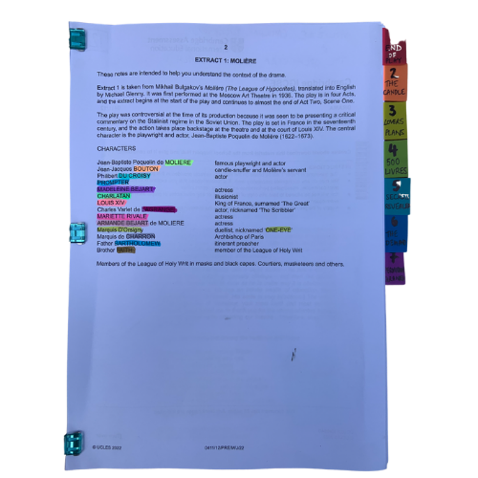
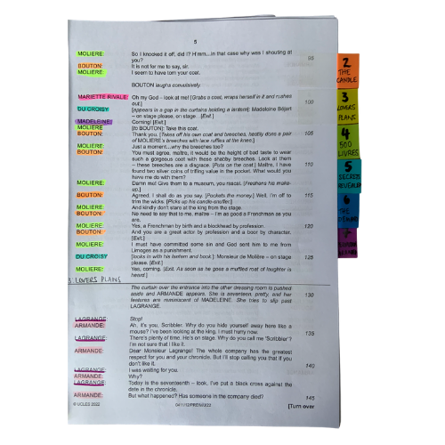
You will be working closely with this script for the next few months so get it organised, so you can access what you need easily, and you can easily see who is in a scene.
The script is two scenes. We’ve broken those down into seven units for our learning.
© Jane Fisher

Slide 12
Choosing a colour for each character and highlighting your whole script allows you to see who is in each scene and makes reading in class (or to yourself) and experimenting with scenes much easier. It also allows you to see how prominent a character is.
Adding tabs to mark each section makes finding your place easy and helps organise the script in your head.
Choosing a colour for each character and highlighting your whole script allows you to see who is in each scene and makes reading in class (or to yourself) and experimenting with scenes much easier. It also allows you to see how prominent a character is.
Adding tabs to mark each section makes finding your place easy and helps organise the script in your head.
© Jane Fisher

Slide 13
In drama analysis, directors and designers often break down the script into units. This makes it easier to analyse what is going on.
Different directors/designers use different ways to decide where a unit starts and ends. Often an entrance or exit of a character is useful as it means, characters intentions change. Each play is unique as is each decision about how to do this.
Different directors/designers use different ways to decide where a unit starts and ends. Often an entrance or exit of a character is useful as it means characters’ intentions change. Each play is unique as is each decision about how to do this.
We like to give each unit a name to help us remember it and to be able to talk about it with our class / company. We try to choose names that are simple and easy reminders of events.
UNIT | 1.1a | 1.1b | 1.2 | 2.1a | 2.1b | 2.2 | 2.3 | 2.4 | 2.5
PAGES | 3 | 3-5 | 5-7 | 8 | 8-9 | 9 | 9-10 | 10-11 | 11-12
LINES | 1-43 | 44-145 | 146-274 | 275-323 | 324-349 | 350-380 | 381-435 | 436-478 | 479-535
NAME | ALONE AND CONFUSED | BEN VISITS WITH SUPPLIES | CBS AND THE SUNSHINE BOYS | PREPARING FOR THE FIRST REHEARSAL | AL’S ARRIVAL | WE’RE BOTH AGAINST IT | THE FIRST REHEARSAL | THE SECOND REHEARSAL | ‘ENTER’
© Jane Fisher

Slide 14
You can complete this document as a class or as individuals. You get deeper understanding and more attention to detail if you each do your own but you share ideas (and workload) if you do it together. Or you could each do your own then share and create a central document. It helps enormously with noticing details and understanding design requirements.
Here’s a blank template with just the first one done as an example
THE SUNSHINE BOYS UNITING - BLANK
© Jane Fisher

Slide 15
You can now read the script together and stop to complete your uniting document and begin a character study, so that when you come to do your second read and practical explorations, you know the characters and the plot of the whole extract and can draw on that knowledge in your activities and explorations of staging them. You can keep character notes on the second tab of the uniting sheets or you can keep notes in your script. See next slide.
© Jane Fisher

Slide 16
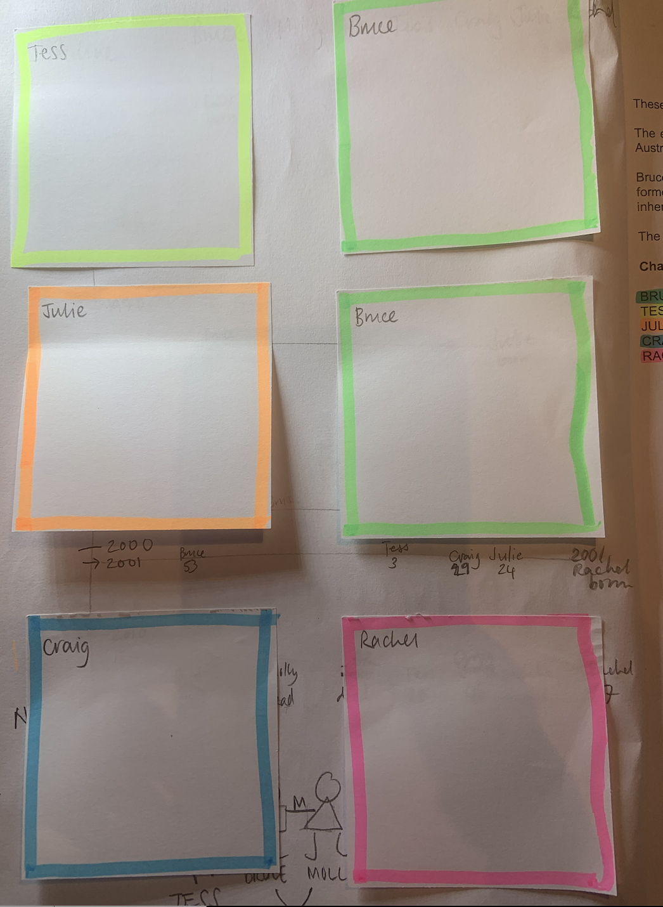
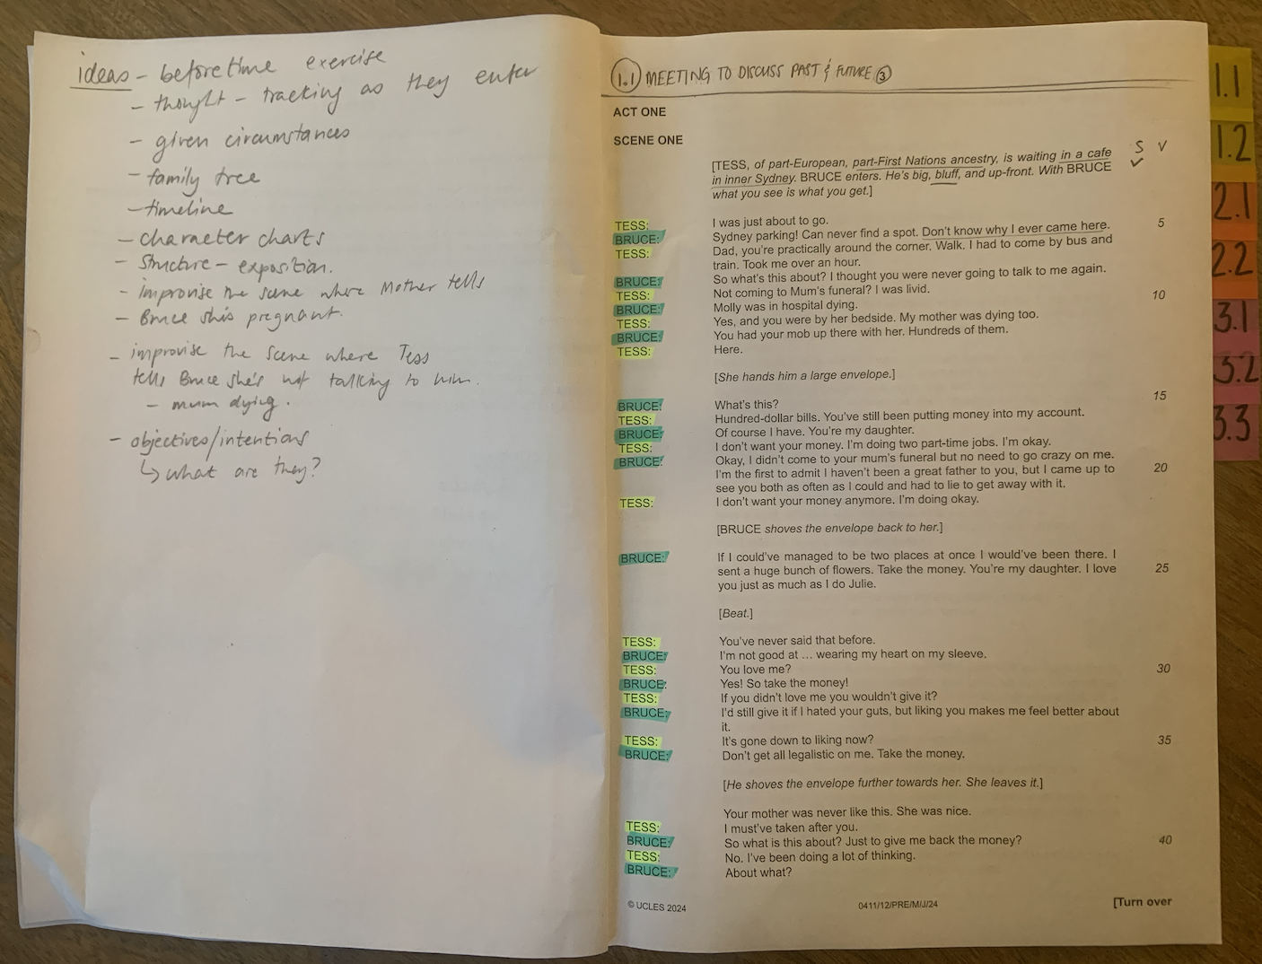
TIPS FOR SCRIPTS & NOTES
We print our script with a blank page next to each page for notes, diagrams for staging etc. We keep all notes in pencil so we can keep changing them as we go on. On the front inside cover we use post-it notes to keep character notes. We can keep adding to these if needed.
Character Notes
Blank page for notes
© Jane Fisher

Slide 17
This resource is a freebie from
www.the-understudy.org
It is designed to help you set up your scripts so that you will find working with our slides to explore this play much easier. And you will feel organised before you embark on your exploration.
The full set of resources are published over a series of dates as we write and publish as we go, due to the time constraints of receiving new material each September. For more details, go to:
https://www.the-understudy.org/igcsedramapre-release
© Jane Fisher

