Slide 1


FREE PRE-READING ACTIVITIES

Slide 2


A NOTE
In case this is your first time with us…
This resource is designed in a hurry to get out fast for those who want to get started, while we work on the actual teaching resources that we design more carefully and professionally.
Just so you know…

Slide 3
Dear Teachers,
This is our freebie resource to introduce the first extracts of the Pre-Release Material for May/June 2026.
We like reading the extract before starting the practical exploration to get a first sense of the play. It means that students have read the extract and gives them time to ‘digest’ the plot and characters, before coming to their practical work and written work. It also means that when they do the practical work, they can draw on their knowledge of how the characters behave in the whole extract in order to shape their ideas.
There is some guidance on the next slide for introducing the play using these slides. Then there are slides for various activities leading up to a first read and a few simple activities to help organise information. We find that students respond very well to having this kind of help with setting up their scripts and being organised - especially those who might usually be the kind to lose scripts, keep half-hearted notes. This is a great opportunity to teach skills of analysis and organisation of ideas. The fact that the extracts are only 15 pages or so means they can keep on top of it and feel successful.
The first set of slides for practical exploration is due out on or before 14 September.
If you would like to pre-order (especially if you need to pay via a bank transfer from school)
you can do so in the shop: www.the-understudy.org/shop.
Just choose ‘manual payment’ at check out in order to generate an invoice.
Otherwise you can buy an instant download as soon as they are published.
Kind regards,
Jane
© Jane Fisher

Slide 4
Teacher notes
INTRODUCTORY LESSON
INTRODUCTORY LESSON
We love to start with a fun introductory lesson before students have any knowledge of the play. It gets them excited about the play and ignites curiosity.
Set up your space like a birthday party. Put out flowers, tea cups, tea?, maybe some gifts, a big pink cake if you have the budget (or any sweet treats will get them hyped!).
Print out the quotes at the end of these slides. Place them in individual envelopes or just fold them. (Envelopes give a nice sense of ceremony.)
Play some fun Russian folk music. (https://www.youtube.com/watch?v=jwsy3SpBwYE)
Invite students in to the party, let them explore, enjoy the food. Maybe even play some
party games as a warm up. (Musical chairs / statues / pass the parcel)
Tell them they will each get a gift of a quote.
They must then get into small groups (probably 2/3)
and create a scene with all their quotes in it.
(Student instructions on next slides.)
There are 10 quotes so if your class is bigger, more than one student can have the same quote. Make sure they are in different groups. It will be interesting to see what different students do with the same quote.

Slide 5

Student
Task
DEVISE A SCENE
Try not to play the scene for laughs. There may be some comic elements but you should not play up to it. Don’t let it dominate the scene.
Work in groups of 2 or 3.
Share your quotes with each other
and discuss what they might mean.
Create a scene which:
- must be set on someone’s birthday
- must be very naturalistic
- must be set in Spring inside a house
- must include at least one of the quotes
your group has been given
Remember that we are looking for naturalism
in one single scene, not silly plots designed to
get the quotes in. How can you work hard to make
meaning and make sense and make us
believe in your characters and their situation?

Slide 6
Student
Task
SHARE & REFLECT
“It’s a sad place for a man to be alone.”
Share your scenes and discuss any emerging themes and ideas.
What did the quotes inspire?

Slide 7
A NOTE FOR TEACHERS
The next exercise is fairly sophisticated so decide whether it’s a good idea for your class or not. If it will lead to them writing weird answers vaguely referencing ‘layers of nature’ at some stage later down the line, it may not be a good idea.
If they are capable and bright and you lead them carefully through it and manage their understanding, it will be excellent preparation for studying the play.
But even then, you will need to be careful that vague remnants of it don’t creep into answers in unhelpful ways later down the line.
Be clear that most written answers expect students to explain what they would do on stage, not what their preparation was - but these exercises can help us to prepare roles with creativity, sensitivity and imagination, which will hopefully lead to better written answers.

Slide 8

Student
Task
KATIE MITCHELL
Watch the first eleven minutes of this video about Katie Mitchell’s approach to Naturalism.
00:00 - 11:00
NATURALISM EXERCISE
www.nationaltheatre.org.uk/learn-explore/schools/teacher-resources/practitioners-in-practice-katie-mitchell-film/
Discuss Mitchell’s 6 layers of Naturalism.
Can you remember what they were and explain them to each other?

Slide 9
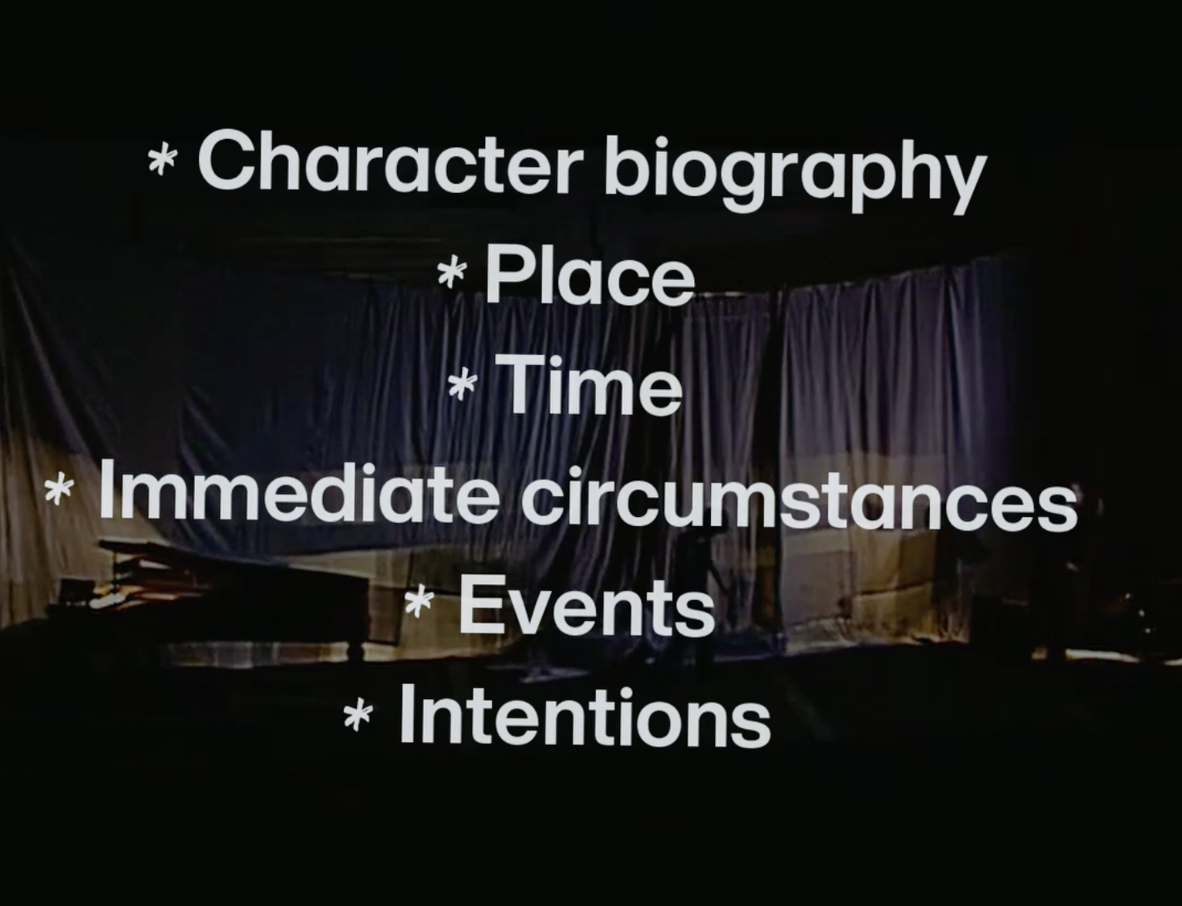
Student
Task
KATIE MITCHELL
Try the exercise that Katie Mitchell did exactly as she did with one actor.
PRACTICAL EXERCISE
You can decide whether to have the teacher lead and all observe one actor, or split into pairs with one actor and one director to lead them through the exercise.

Slide 10
Student
Task
KATIE MITCHELL
AND/OR
Try the exercise that Katie Mitchell did exactly as she did with one actor walking into a room.
PRACTICAL EXERCISE
Character biography: The incidents in a character’s past which create their behaviour in the present.
You are a 28 year old woman. A teacher. Unmarried.
You live at your parents’ home that you moved to 11 years ago. Your parents are both dead.

Slide 11
Student
Task
KATIE MITCHELL
AND/OR
Try the exercise that Katie Mitchell did exactly as she did with one actor walking into a room.
PRACTICAL EXERCISE
Place: The location where the action of the scene happens.
You are walking into the dining room. The table is laid. There is a large cake.

Slide 12
Student
Task
KATIE MITCHELL
AND/OR
Try the exercise that Katie Mitchell did exactly as she did with one actor walking into a room.
PRACTICAL EXERCISE
Time: The year, season, day of the week and time of day the scene takes place in.
It is Spring. Midday. The sun is shining. It is a Saturday.

Slide 13
Student
Task
KATIE MITCHELL
AND/OR
Try the exercise that Katie Mitchell did exactly as she did with one actor walking into a room.
PRACTICAL EXERCISE
Immediate circumstances: The incidents that happen in the 24 hours before the scene starts that affect the character’s mood and behaviour.
You have had a headache that you have had for days. It is your youngest sister’s 20th birthday and the one year anniversary of your father’s death.

Slide 14
Student
Task
KATIE MITCHELL
AND/OR
Try the exercise that Katie Mitchell did exactly as she did with one actor walking into a room.
PRACTICAL EXERCISE
Intentions: What the character wants the other character(s) to do, feel or say.
You want to comfort and celebrate your sister - to make her feel good.

Slide 15
KATIE MITCHELL’S SIX LAYERS OF NATURALISM
Character biography: The incidents in a character’s past which create their behaviour in the present.
Place: The location where the action of the scene happens.
Time: The year, season, day of the week and time of day the scene takes place in.
Immediate circumstances: The incidents that happen in the 24 hours before the scene starts that affect the character’s mood and behaviour.
Events: The changes in the scene that affect the thoughts, feelings or actions of all the characters.
Intentions: What the character wants the other character(s) to do, feel or say.
Now see if you can go back to your scene you created and apply these six layers. If this is too challenging to do in groups, perhaps the whole class can work on one scene, making offers and suggestions while just the 2/3 people play the scene.
You want to comfort and celebrate your sister - to make her feel good.

Slide 16
Student
Task
SHARE & REFLECT
“Look at you now, you’re wearing white again. You’re radiant.”
How has this exercise helped develop your understanding of a naturalistic style of acting?
What are you curious about in terms of the play we are about to study based on everything you have experienced today?

Slide 17
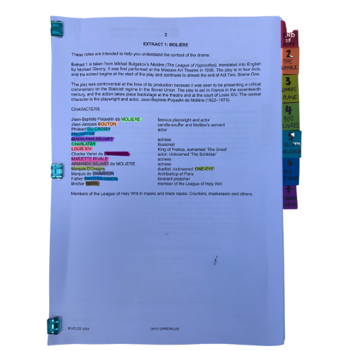
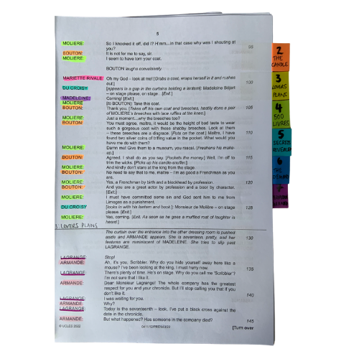


PREPARING YOUR SCRIPT
You will be working closely with this script for the next few months so get it organised, so you can access what you need easily, and you can easily see who is in a scene.
The script is two scenes. We’ve broken those down into seven units for our learning.
© Jane Fisher

Slide 18

PREPARING YOUR SCRIPT
Choosing a colour for each character and highlighting your whole script allows you to see who is in each scene and makes reading in class (or to yourself) and experimenting with scenes much easier. It also allows you to see how prominent a character is.
Adding tabs to mark each section makes finding your place easy and helps organise the script in your head.
© Jane Fisher

Slide 19

Different directors/designers use different ways to decide where a unit starts and ends. Often an entrance or exit of a character is useful as it means characters’ intentions change. Each play is unique as is each decision about how to do this.
In drama analysis, directors and designers often break down the script into units. This makes it easier to analyse what is going on.
We like to give each unit a name to help us remember it and to be able to talk about it with our class / company. We try to choose names that are simple and easy reminders of events.
UNIT | 1 | 2 | 3 | 4 | 5 | 6 | 7
PAGES | 3-4 | 4-5 | 5-7 | 7-9 | 9-11 | 11-13 | 13-16
LINES | 1-74 | 75-133 | 134-205 | 206-321 | 322-394 | 395-497 | 498-585
NAME | LONGING | TO WORK | CAKE & GIFT | NEW BATTERY COMMANDER | LOVESICK | A TOAST | BURNT
© Jane Fisher

Slide 20
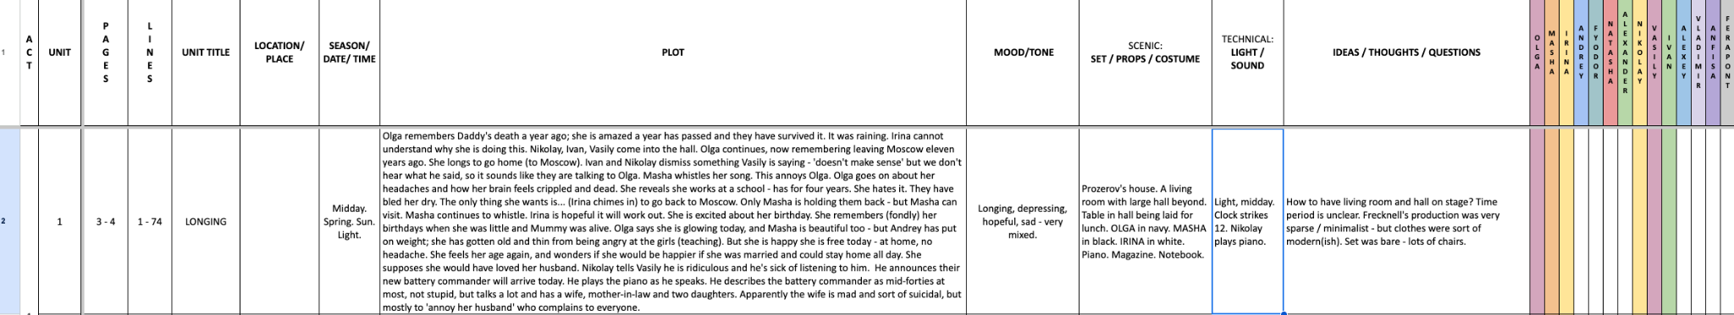
You can complete this document as a class or as individuals. You get deeper understanding and more attention to detail if you each do your own but you share ideas (and workload) if you do it together. Or you could each do your own then share and create a central document. It helps enormously with noticing details and understanding design requirements.
Here’s a blank template with just the first one done as an example
BLANK THREE SISTERS UNITS.xlsx
© Jane Fisher

Slide 21

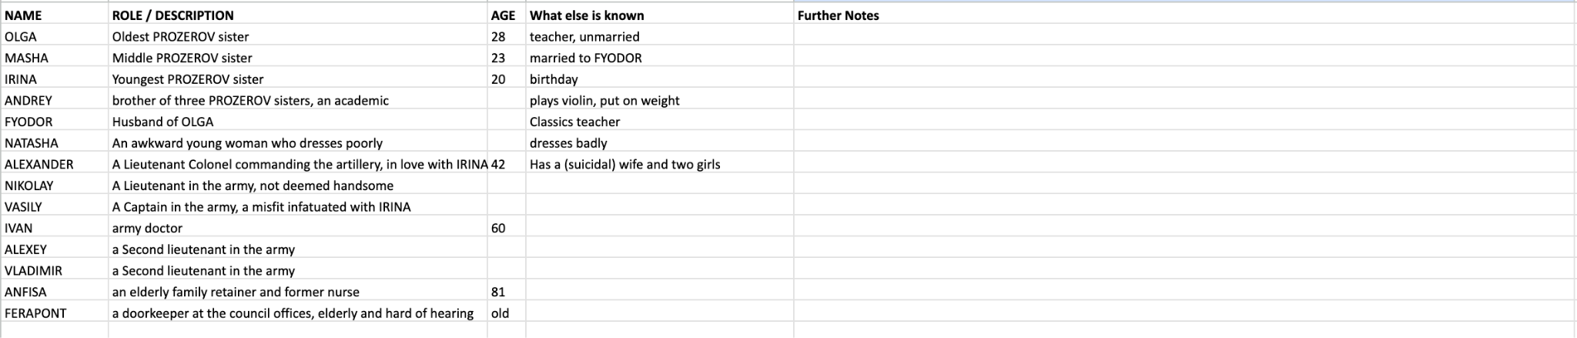
READ THE SCRIPT TOGETHER
You can now read the script together and stop to complete your uniting document and begin a character study, so that when you come to do your second read and practical explorations, you know the characters and the plot of the whole extract and can draw on that knowledge in your activities and explorations of staging them. You can keep character notes on the second tab of the uniting sheets or you can keep notes in your script. (See next slide.)
© Jane Fisher

Slide 22
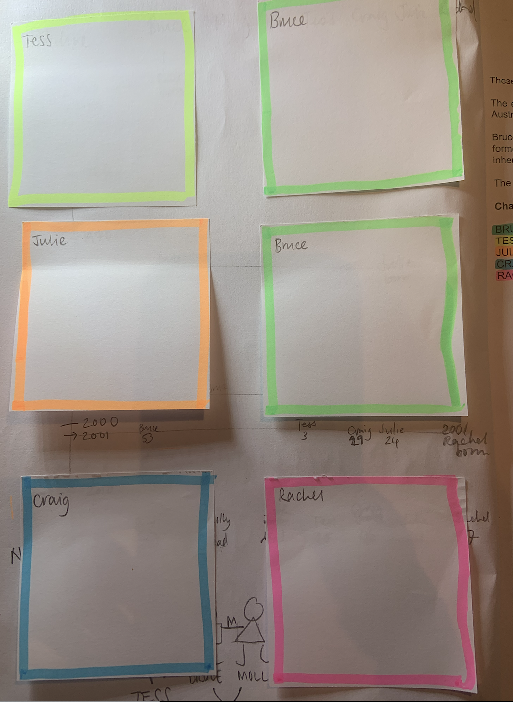
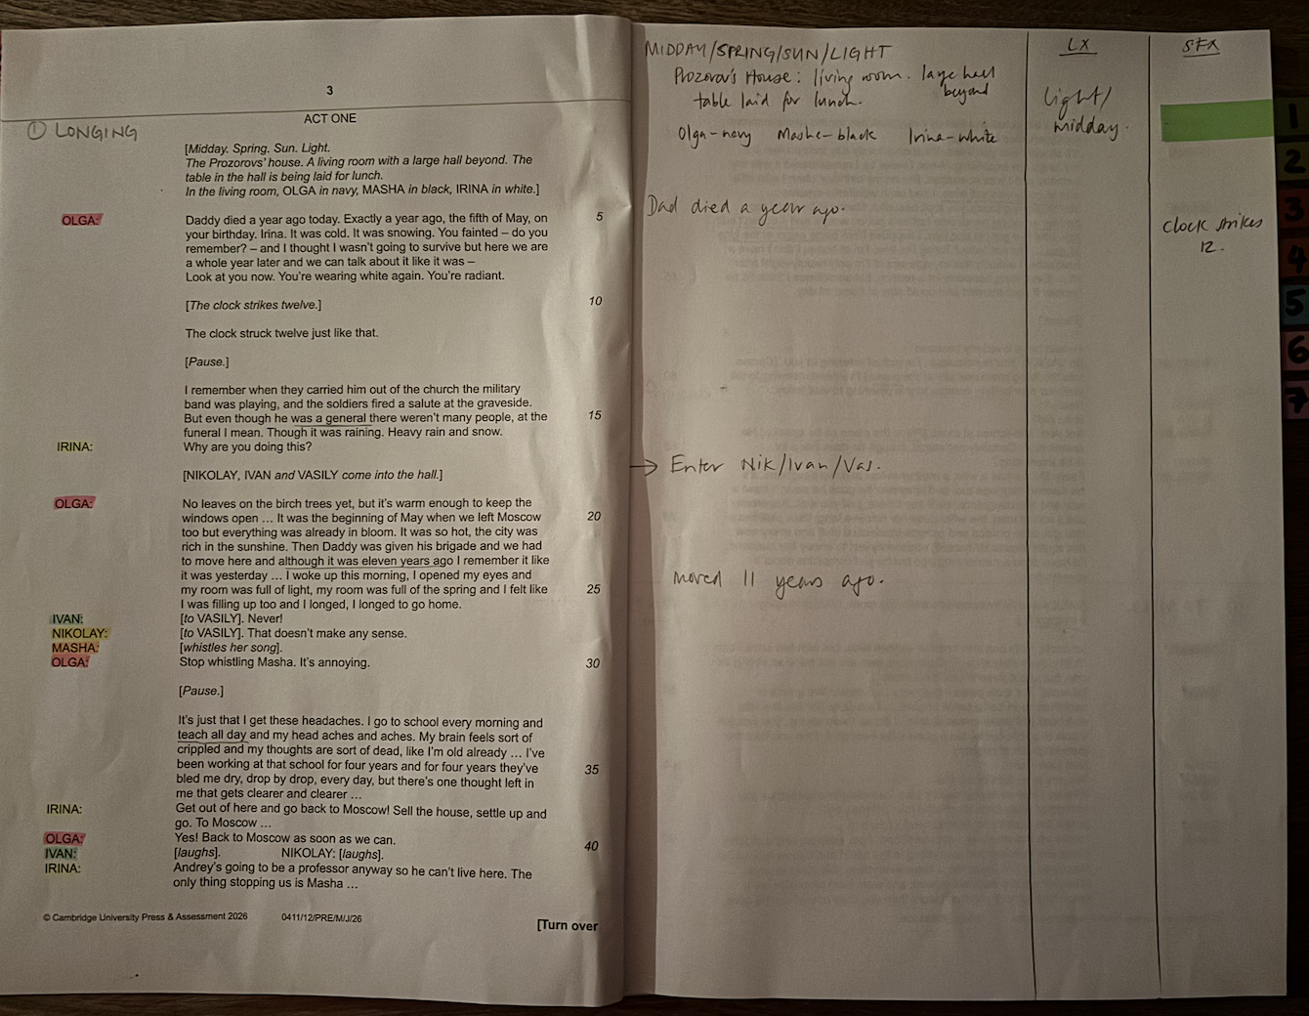
We print our script with a blank page next to each page for notes, diagrams for staging etc. We keep all notes in pencil so we can keep changing them as we go on.
On the front inside cover we use post-it notes to keep character notes. We can keep adding to these if needed.
TIPS FOR SCRIPT NOTES
Character Notes
Blank page for notes
© Jane Fisher

Slide 23
MAKE A FAMILY TREE
After (or during) your first reading, create a quick “family tree”, showing all the characters in the play and their relationships. To each other and to others mentioned.
Include spouses and others who are mentioned in the play so you can keep a tab on who is married, divorced, orphaned etc.
Find the best way to represent the web of relationships that are portrayed in the play.
Extension: pick a quote that shows something about the relationship.
These do not need to be neat and pretty diagrams: a quick pencil sketch will do the job that you need it to. It’s to help you to understand the relationships and history. It’s the act of doing it that is the learning. Maybe use the colours you’ve been using for highlighting. This is especially useful for this play with lot of characters.
© Jane Fisher

Slide 24
“I woke up this morning, I opened my eyes and my room was full of light, my room was full of the spring and I felt like I was filling up too, and I longed, longed to go home.”

Slide 25
“It’s just that I get these headaches… My brain feels sort of crippled and my thoughts are sort of dead…”

Slide 26
“Apparently she’s sort of mad, the wife, does her hair in a long, thick plait like a little girl, talks politics and pseudo-intellectual stuff and every now and again tries to kill herself, apparently just to annoy her husband.”

Slide 27
“Today I’m free, I’m at home, I don’t have a headache, I actually feel my age again.”

Slide 28
“The world is changing, you can feel the weight of it building in the air.”

Slide 29
“There’s a great storm coming, coming closer and closer and it’s going to break over all our laziness and indifference and apathy, and cleanse the rotten heart right out of our society.”

Slide 30
“In twenty-five years you’ll be dead. If you don’t have a stroke first, I’ll crack and put a bullet in your brain.”

Slide 31
“Why is he always doing these embarrassing things?”

Slide 32
“I was reading until four in the morning and when I went to bed these thoughts were just going round and round in my head.”

Slide 33
“The strange thing is we can’t know what will or won’t be considered meaningful and important in the future .”

Slide 34
“He isn’t in love, he does have some taste after all. He’s just trying to annoy us.”

Slide 35

This resource is a freebie from
www.the-understudy.org
It is designed to help you set up your scripts so that you will find working with our slides to explore this play much easier. And you will feel organised before you embark on your exploration.
The full set of resources are published over a series of dates as we write and publish as we go, due to the time constraints of receiving new material each September. For more details, go to:
https://www.the-understudy.org/igcsedramapre-release
© Jane Fisher

